Slide 1
EUROPEAN SCHOOLS STAND AGAINST BULLYING
EVALUATION FOR STUDENTS
MEETING IN ITALY TODI
28 MARCH-1 APRIL 2022

Slide 2
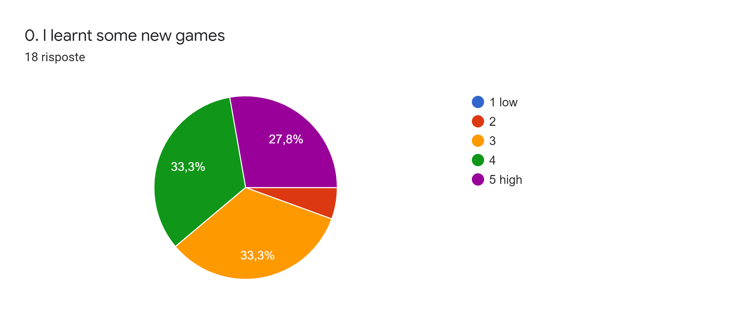

Slide 3
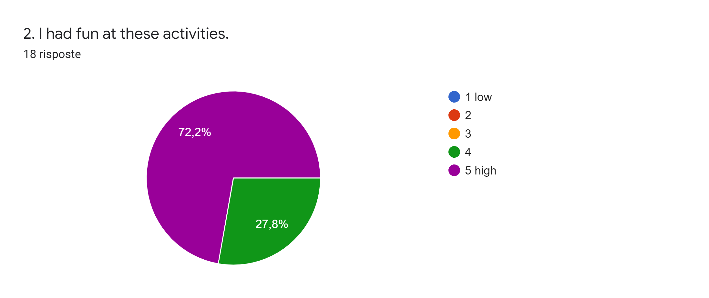

Slide 4
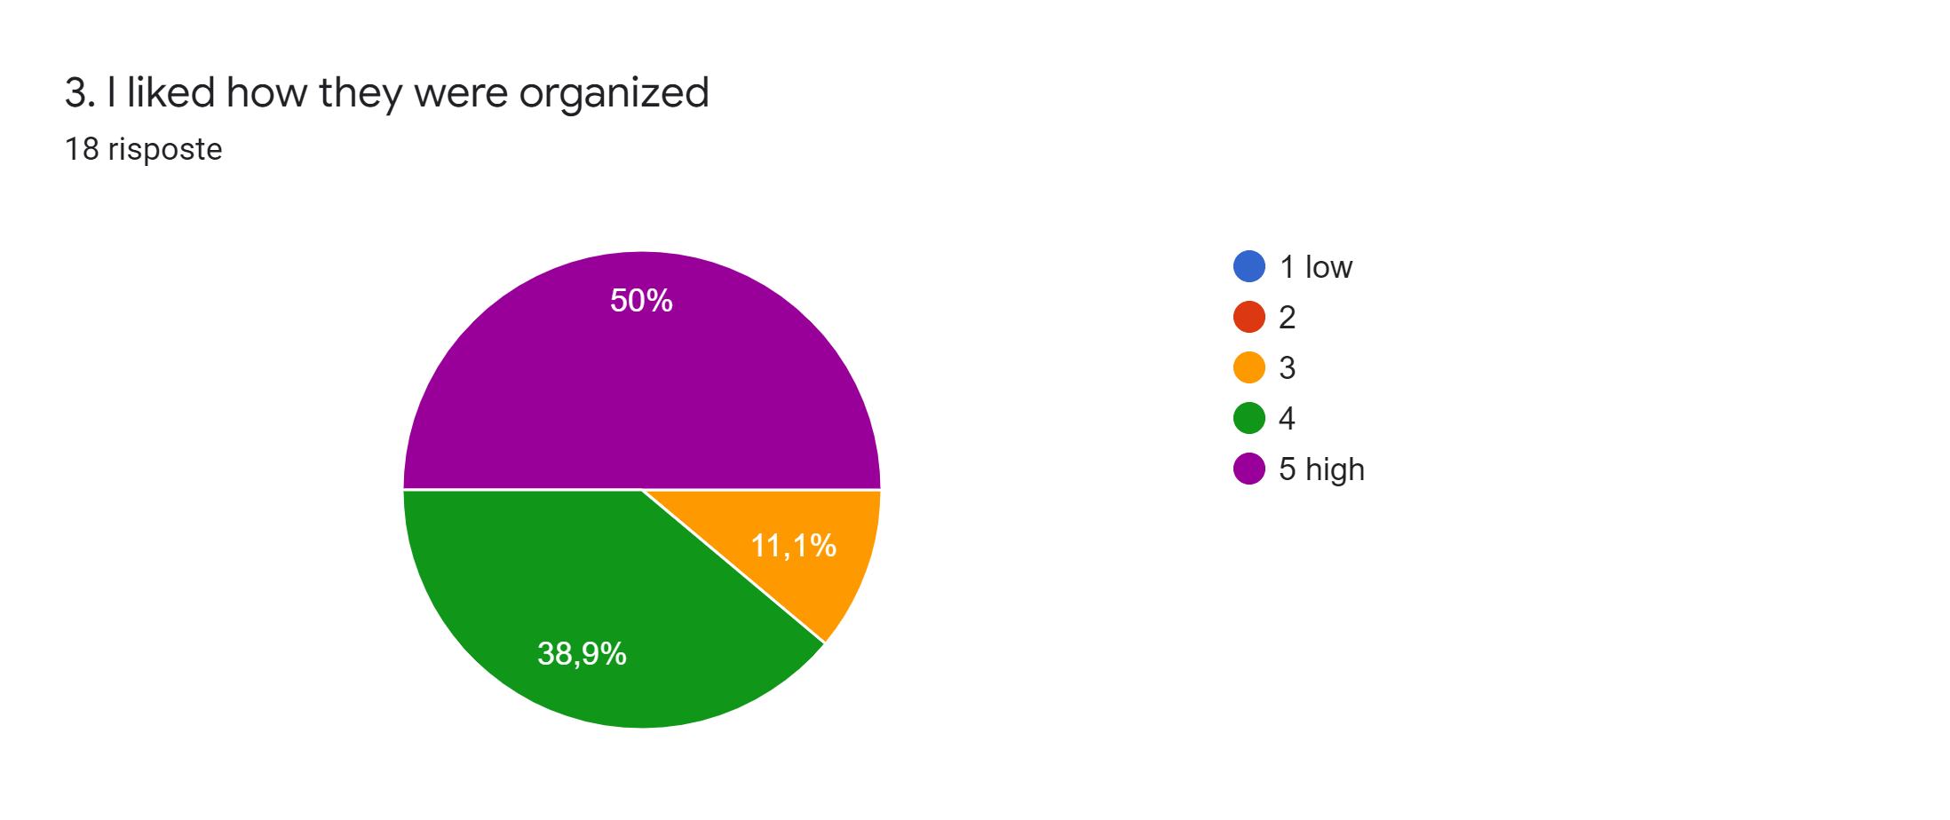

Slide 5
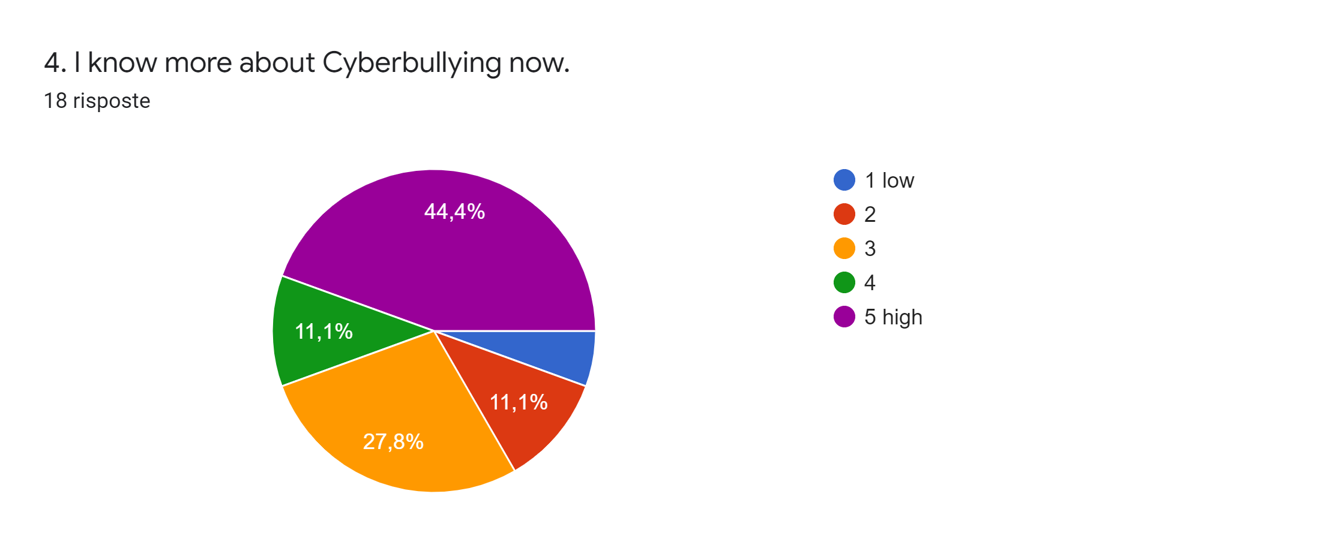

Slide 6
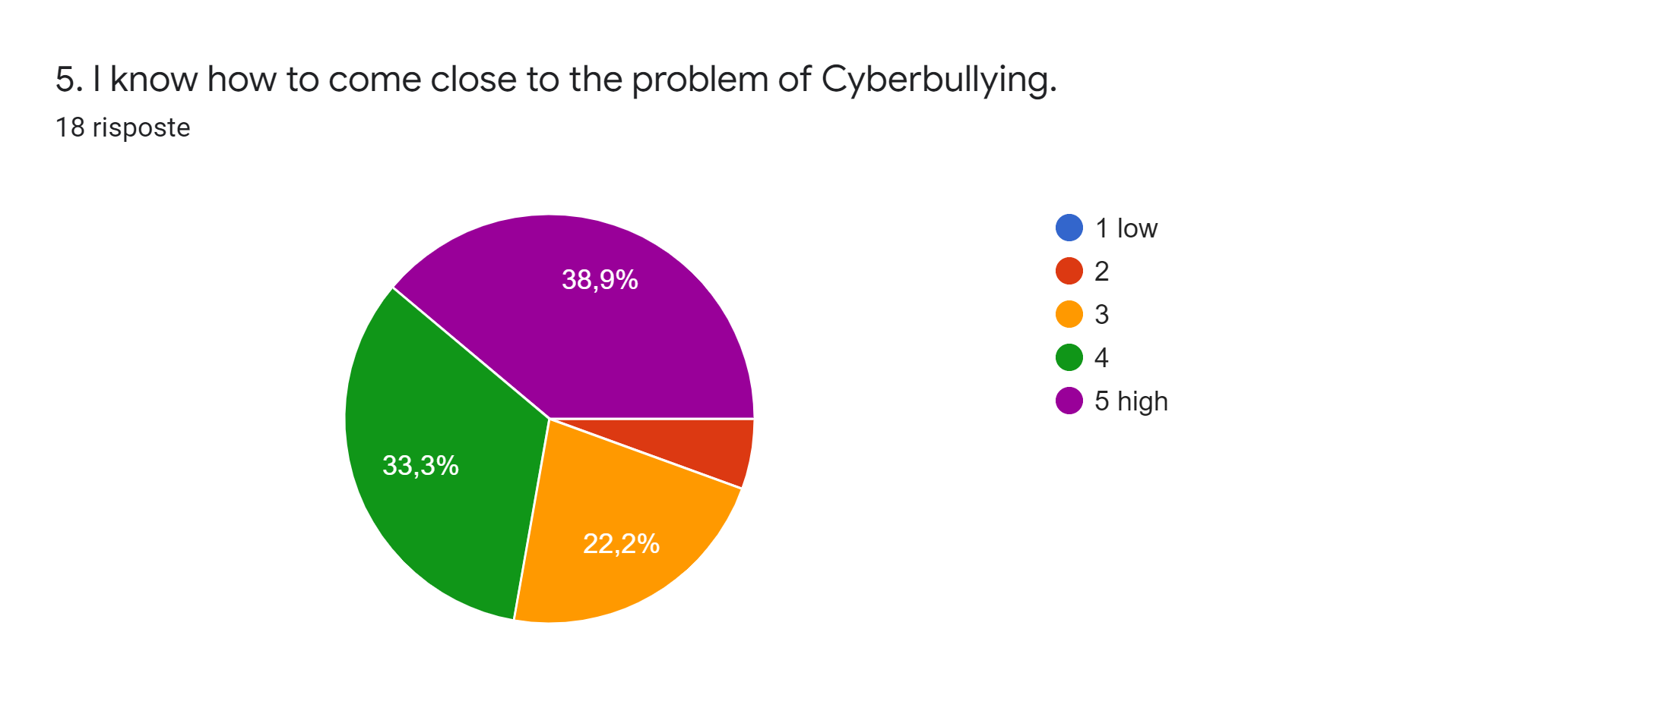

Slide 7
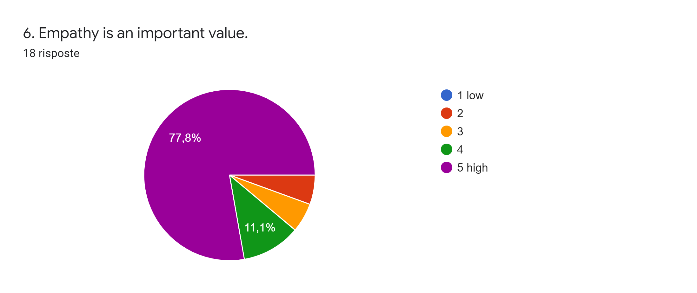

Slide 8
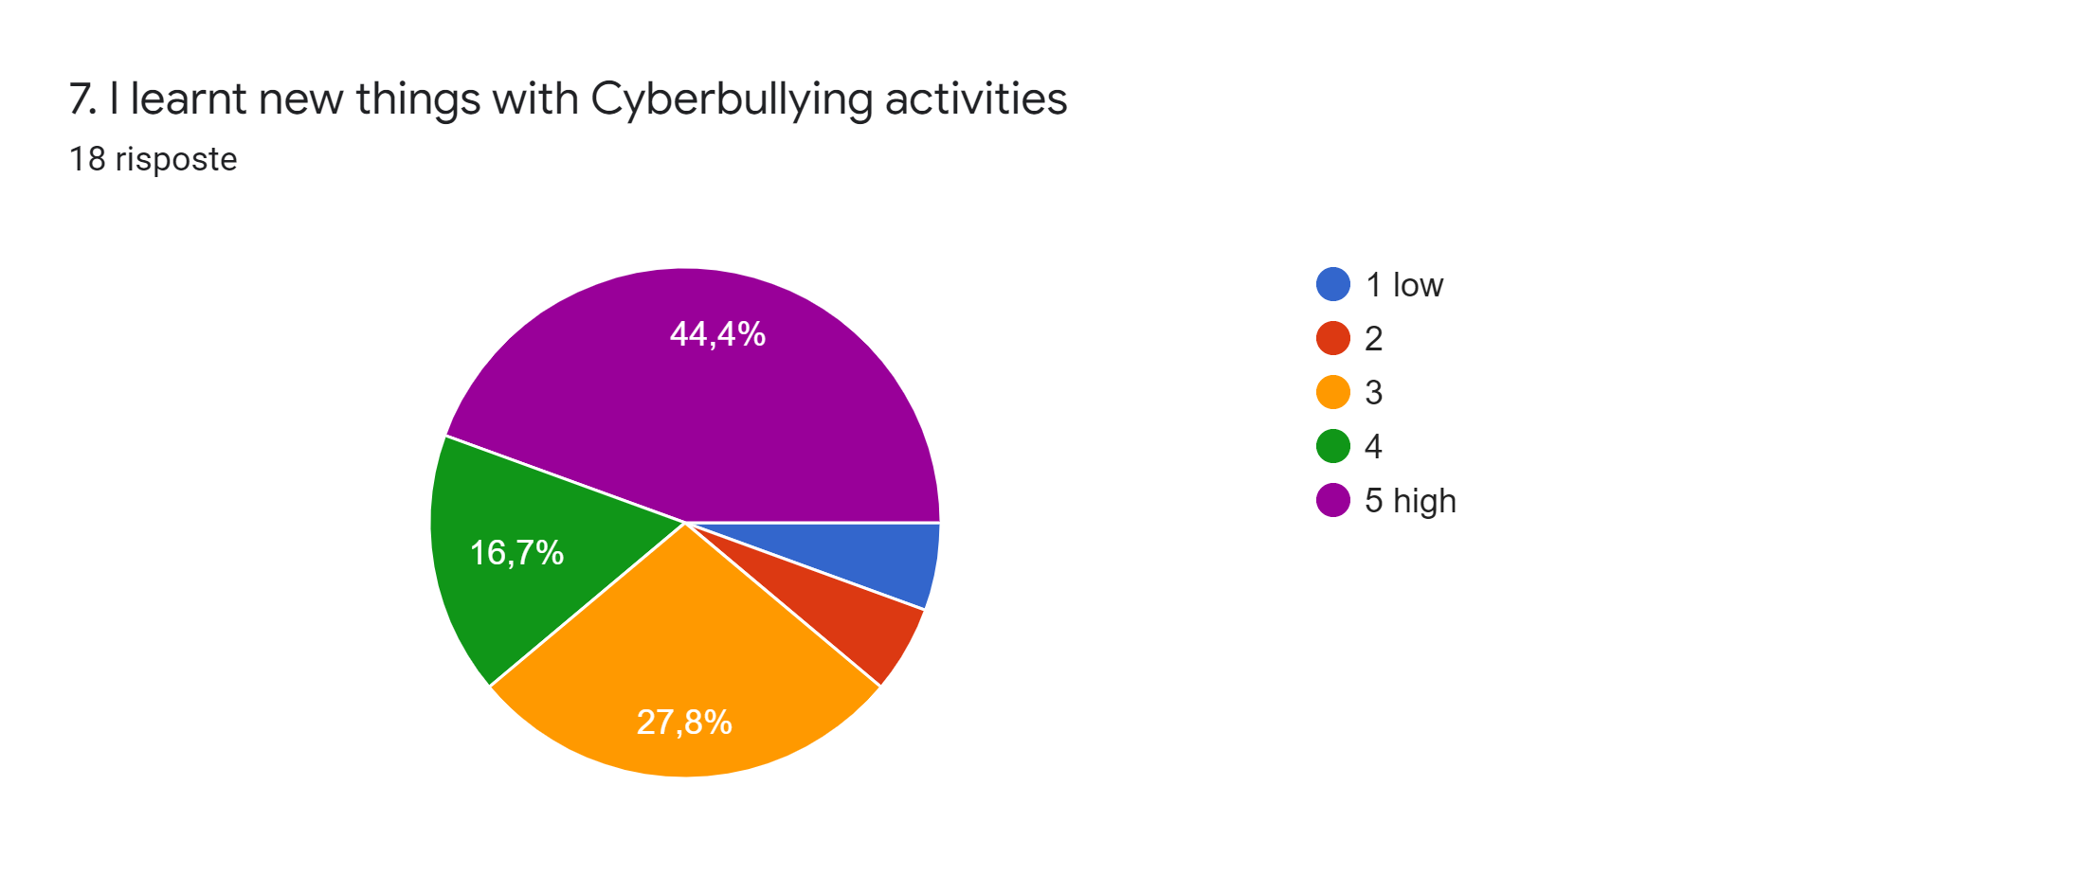

Slide 9
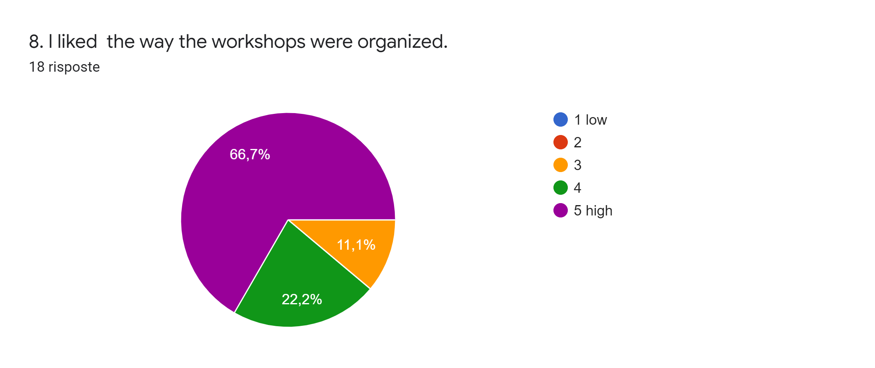

Slide 10
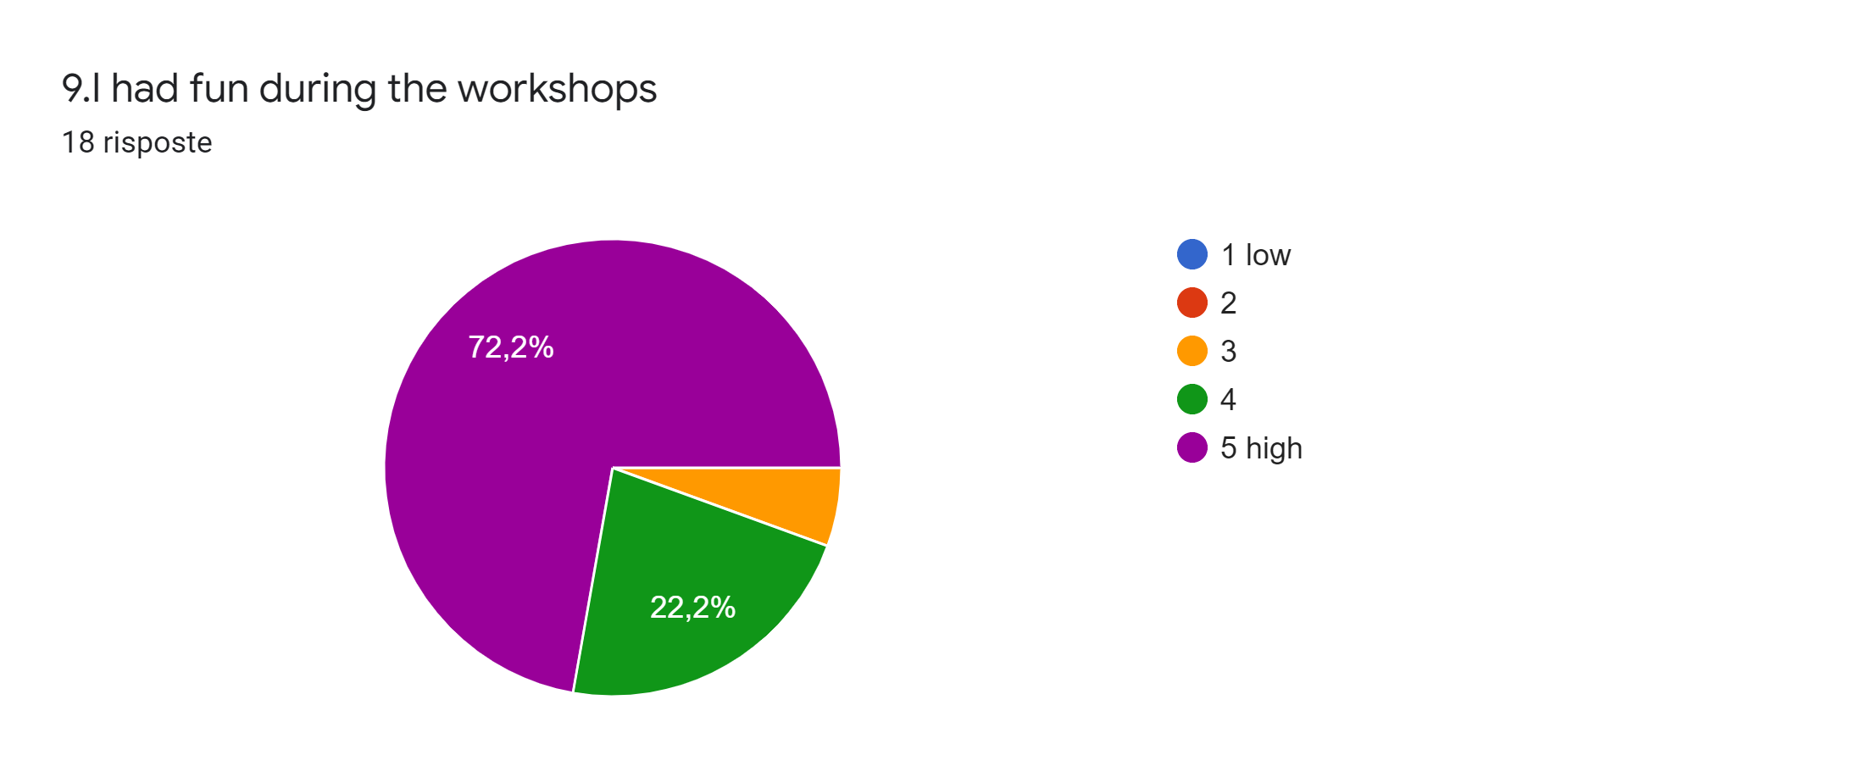

Slide 11
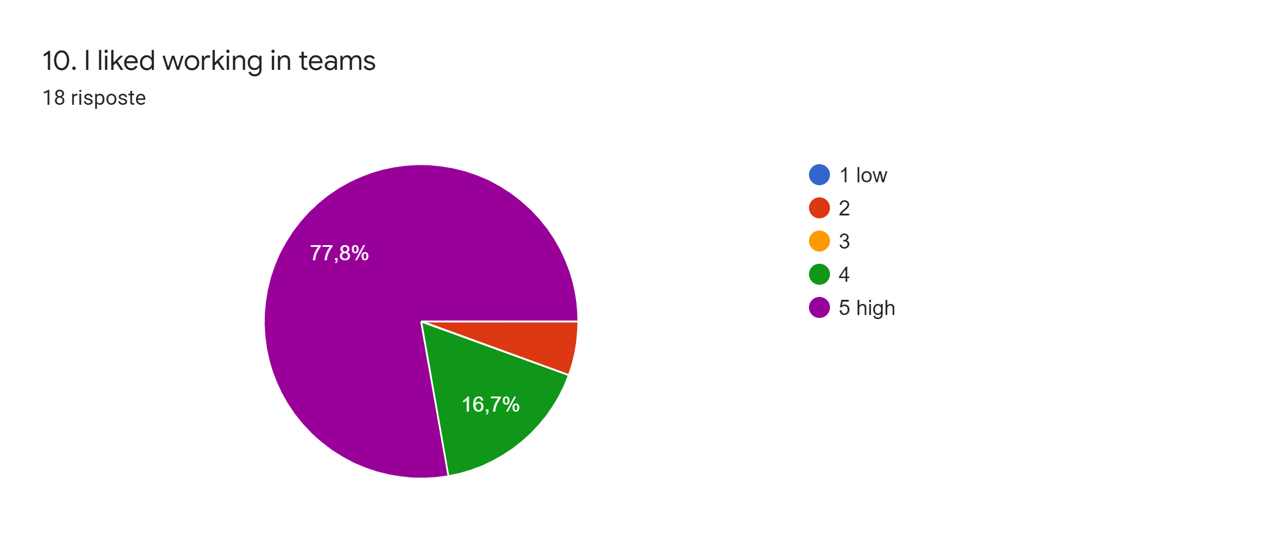

Slide 12
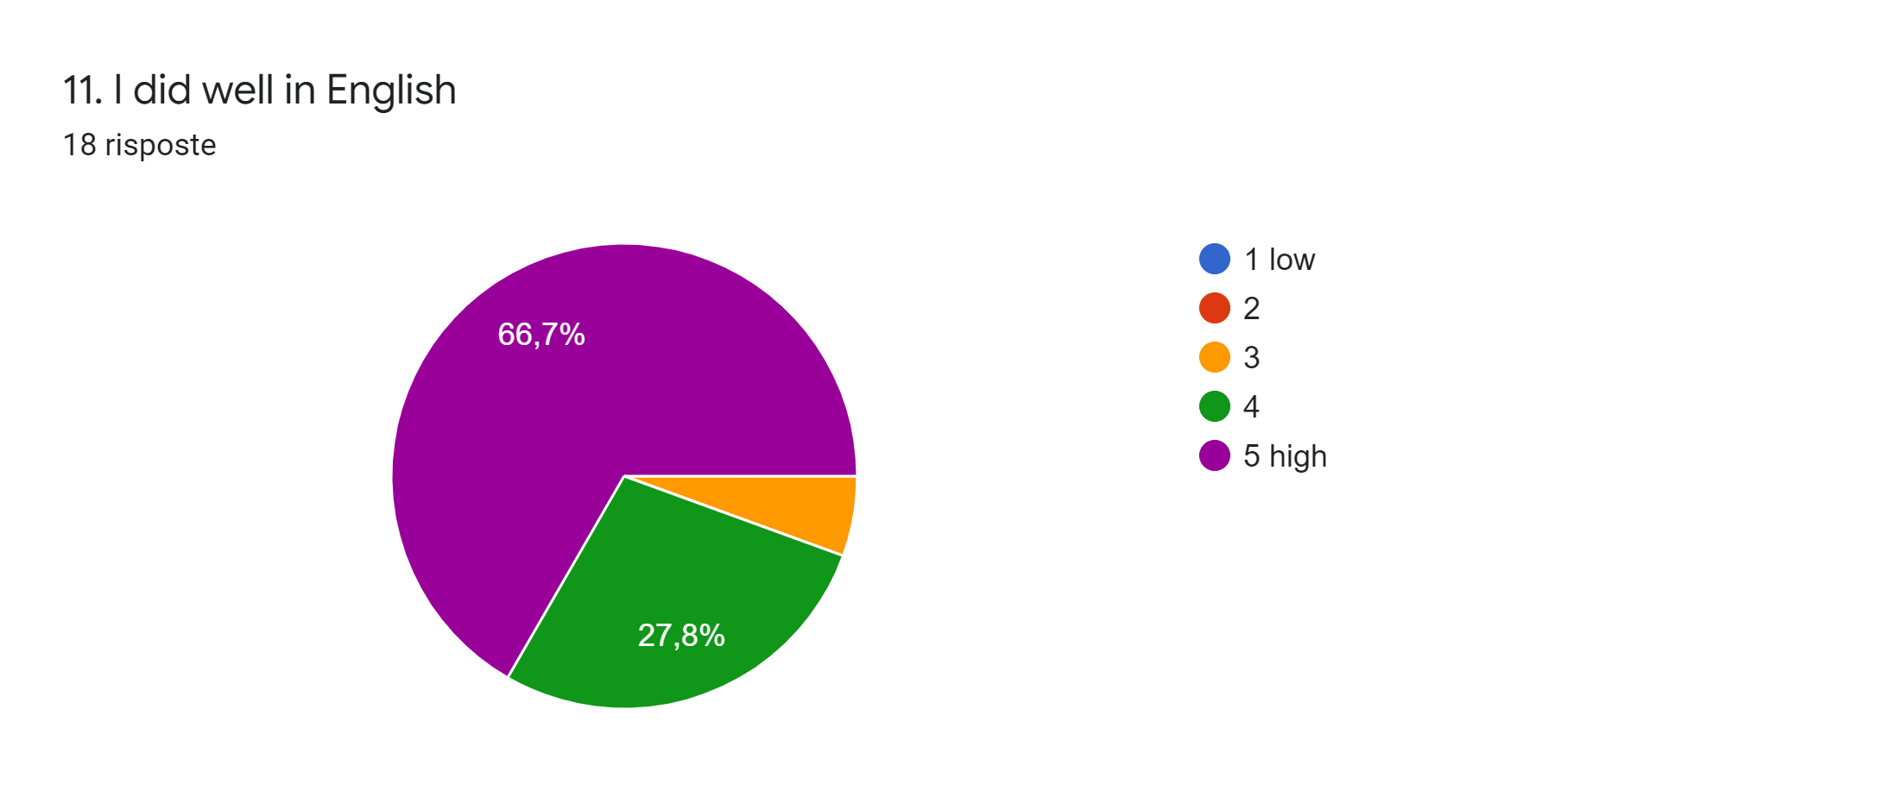

Slide 13
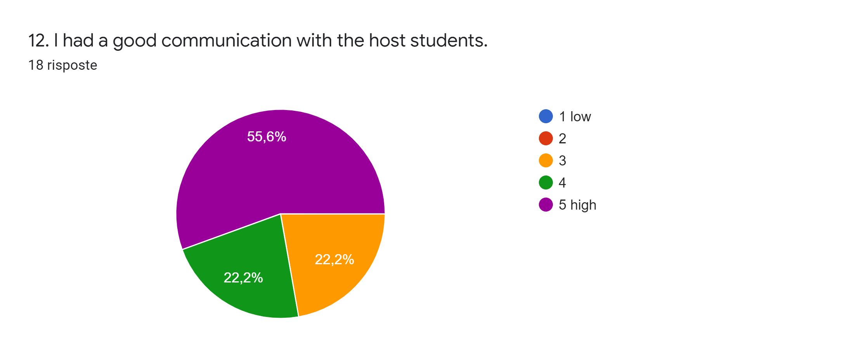

Slide 14
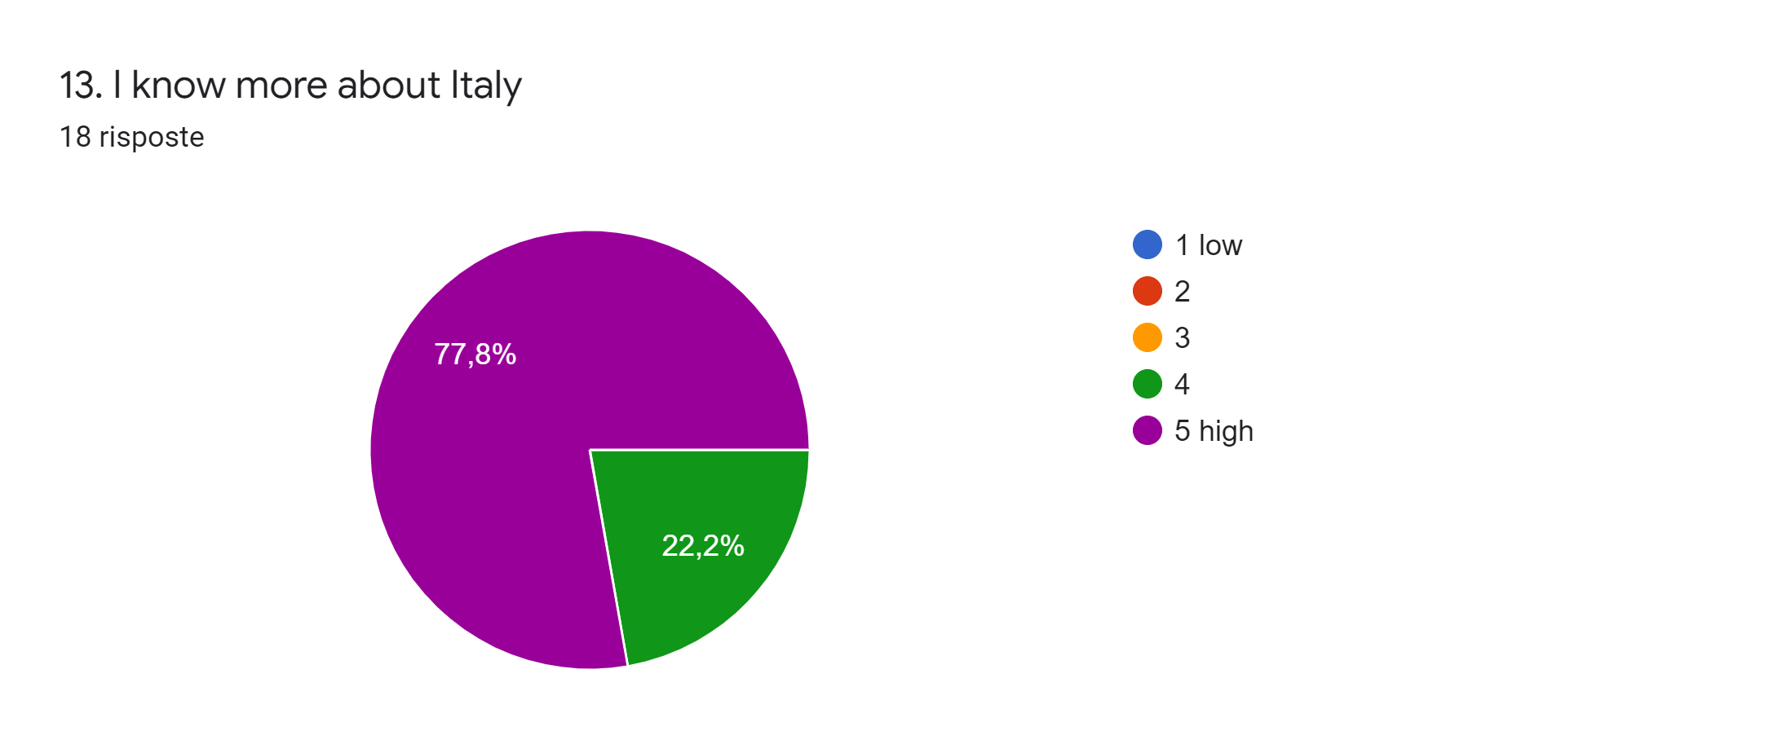

Slide 15
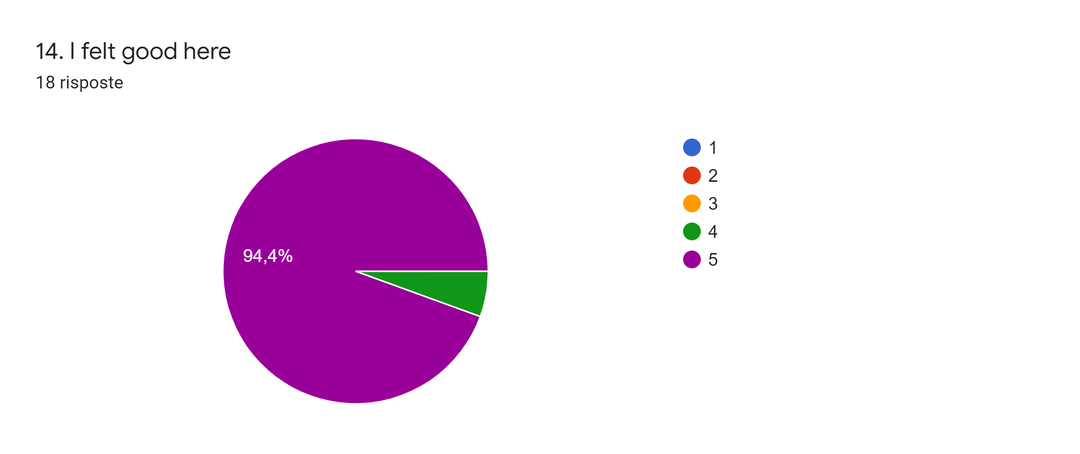

Slide 16
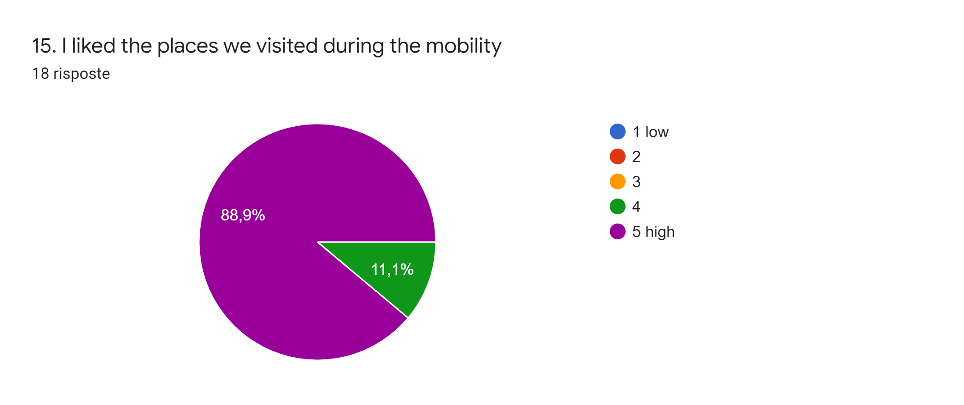

Slide 17
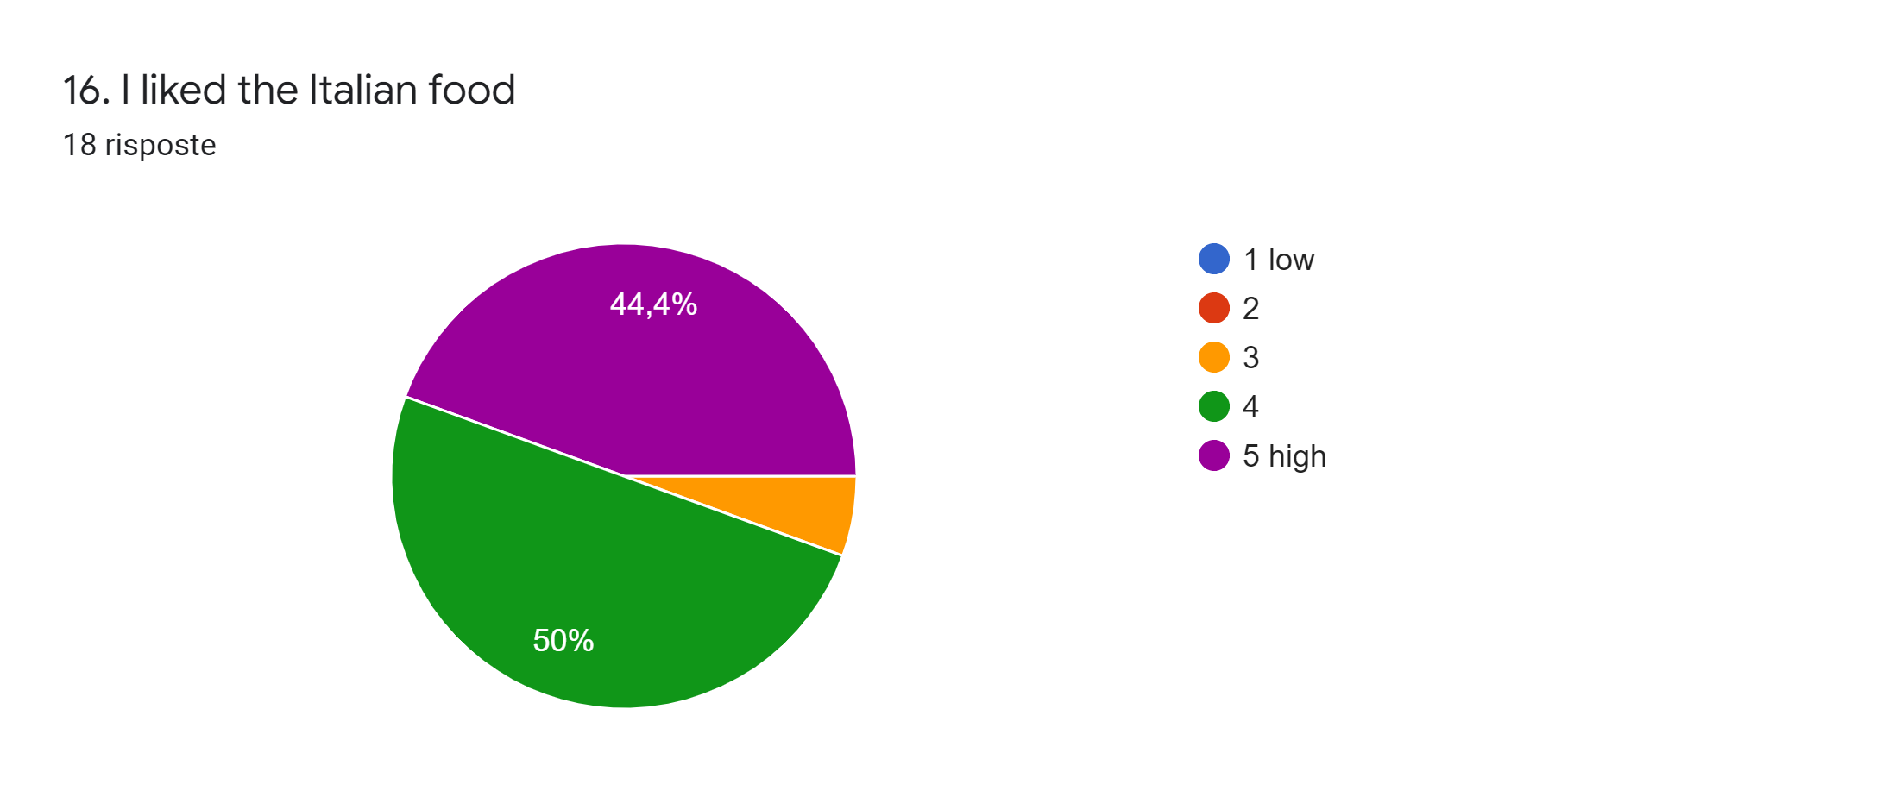

Slide 18
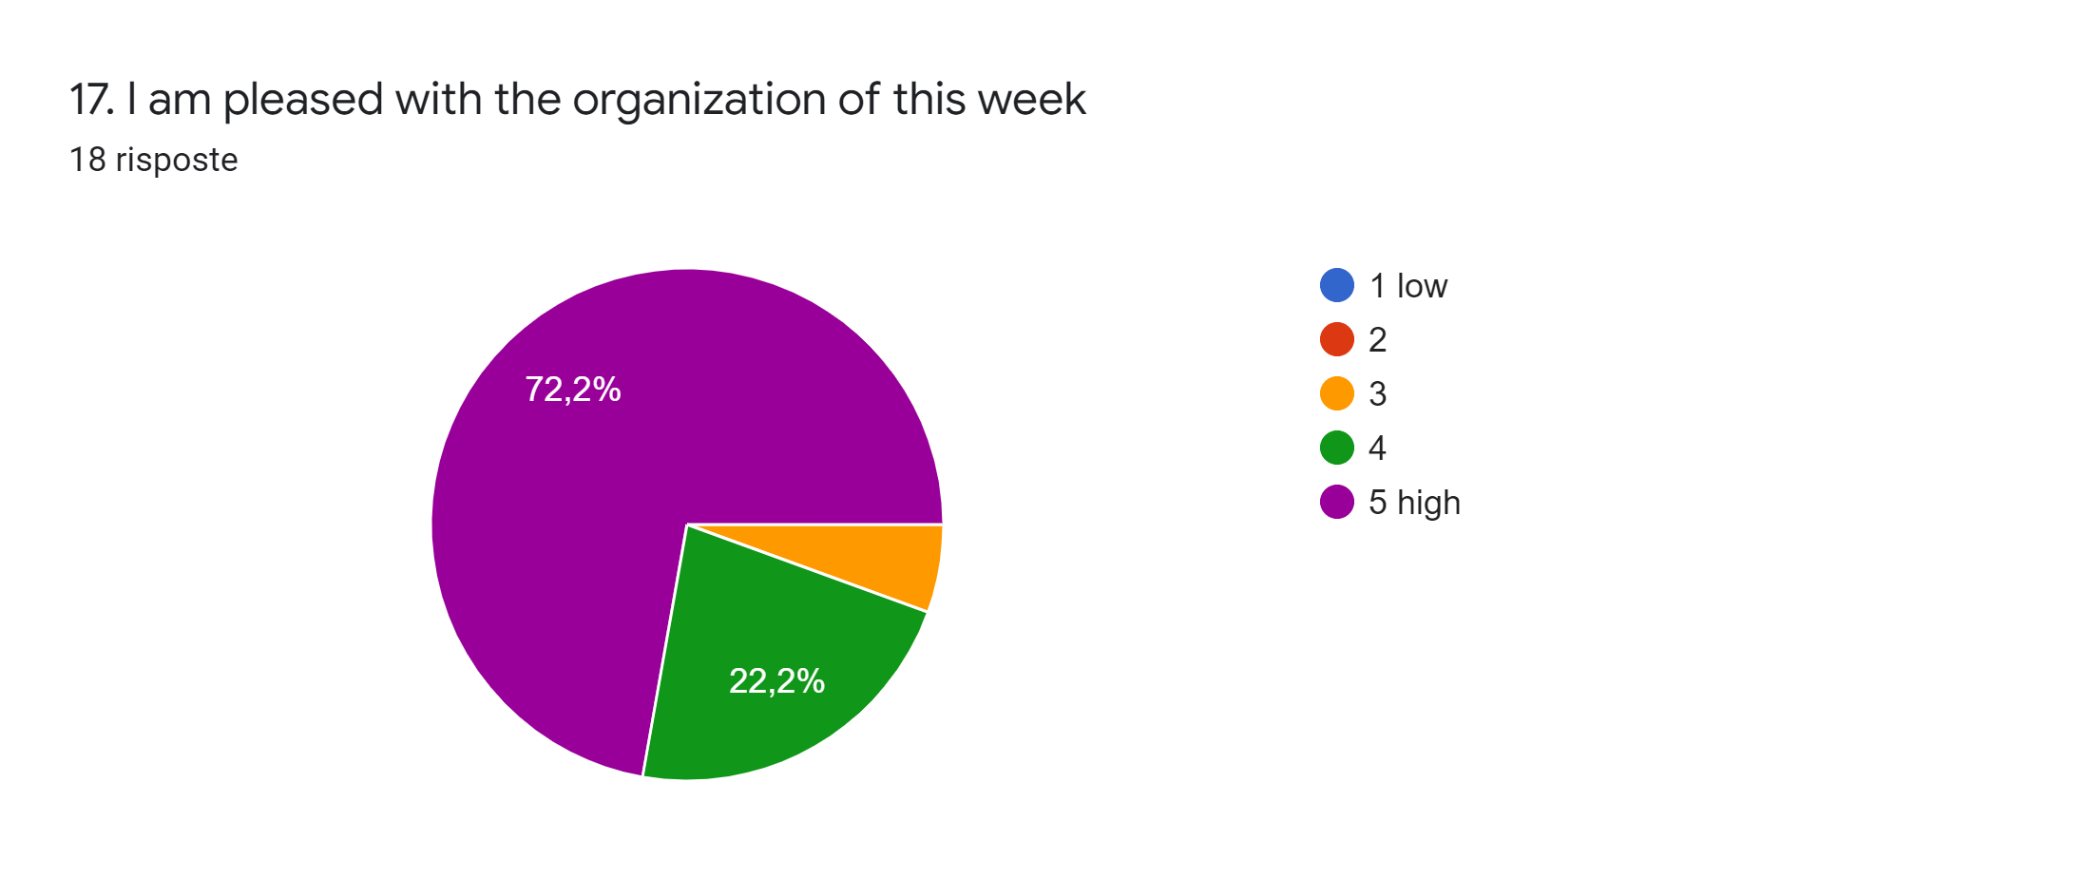

Slide 19
18. Write the best thing you had in our country18 risposte
The fun I had, not only because of the places we visited, but also thanks to all the sudents and teachers.
the best of Italy is the monuments everywhere.
The whole experience it self
The food and the monuments
I liked the people.
I liked the colosseum
music choir
Tarihi yerler
pizzas and churches

Slide 20
My holidays during the night in the hotels
I really enjoyed the time when I met the other children on the Erasmus
I think the best thing in our country is our historical artifacts.
The architecture
I liked the food
I liked seeing the Catholic churches and the statues and organs inside them
The friends I have made along the way
Suvenir
I loved Todi so much, it is truly beautiful and i loved meeting all the nice students from the school

Slide 21
CONCLUSION
THE RESULTS GIVEN BY THE STUDENTS PRESENT TO THE MEETING WERE VERY POSITIVE AS PER GRAPHICS ABOVE

