Slide 1
EUROPEAN SCHOOLS STAND AGAINST BULLYING
EVALUATION FOR TEACHERS
MEETING IN ITALY TODI
28 MARCH-1 APRIL 2022

Slide 2
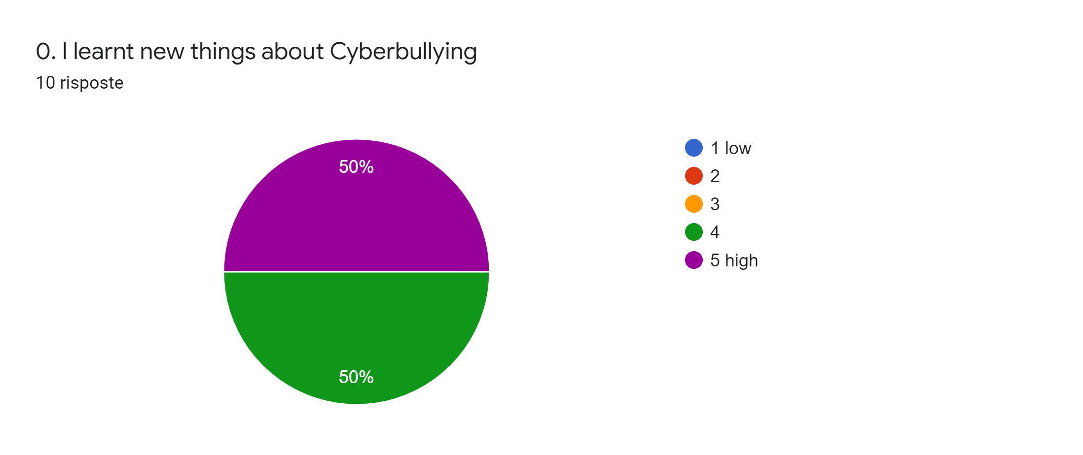

Slide 3
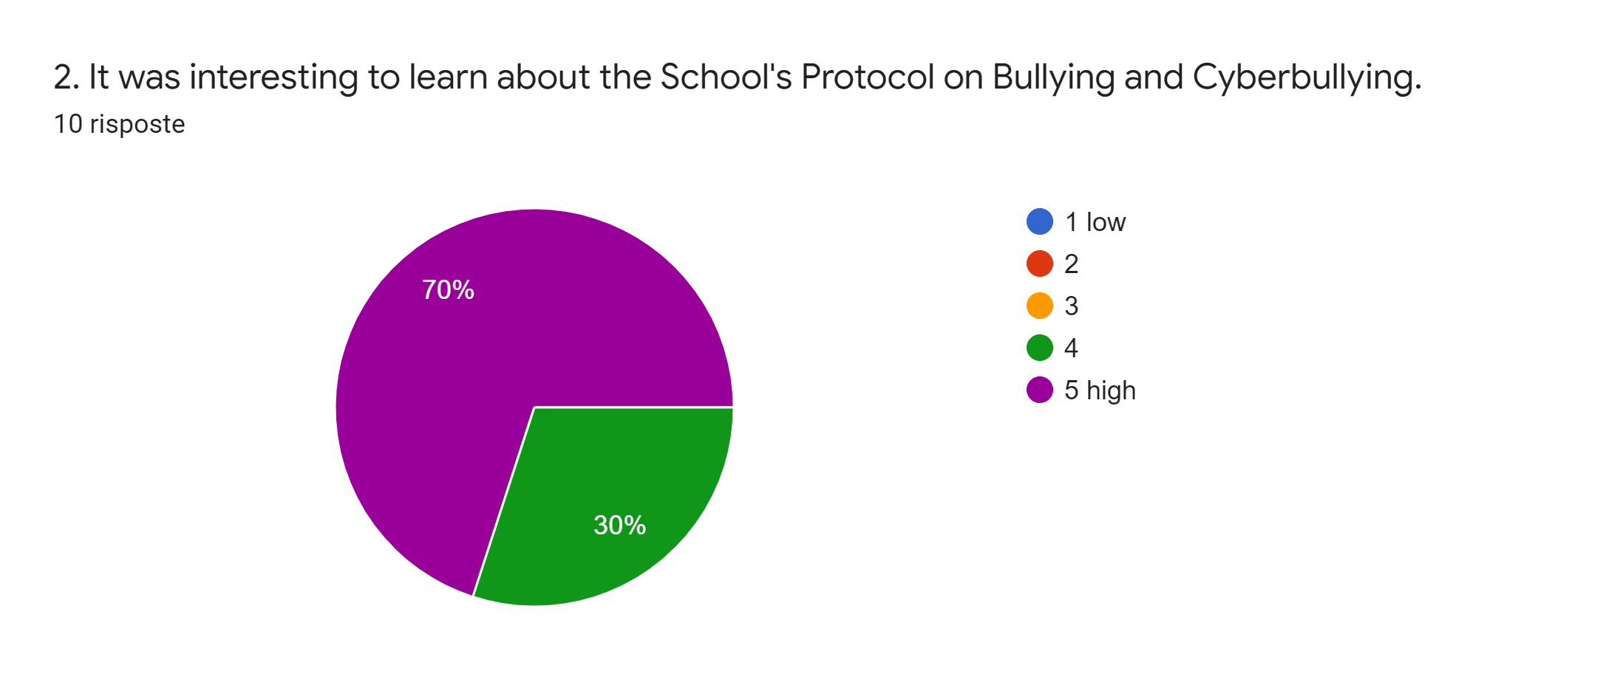

Slide 4
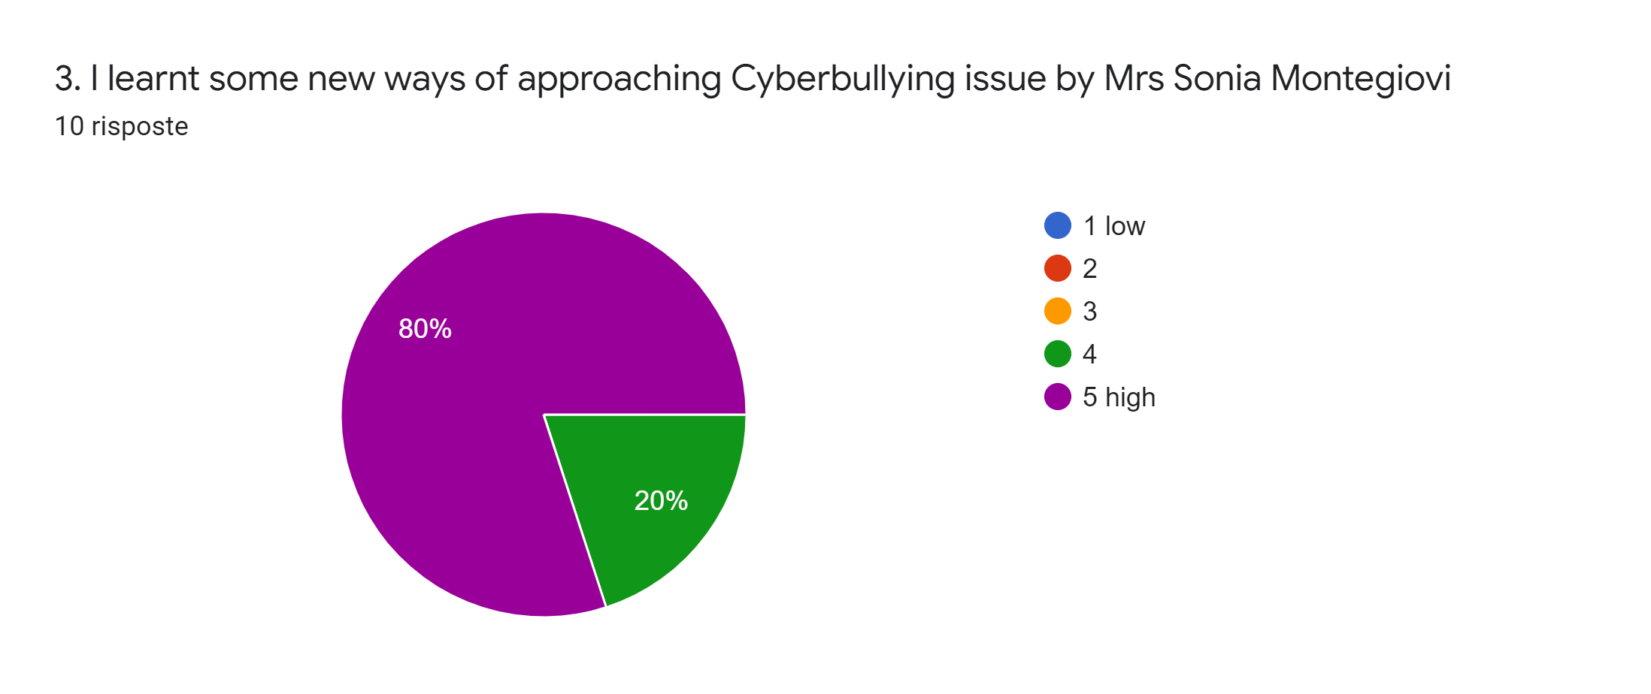

Slide 5
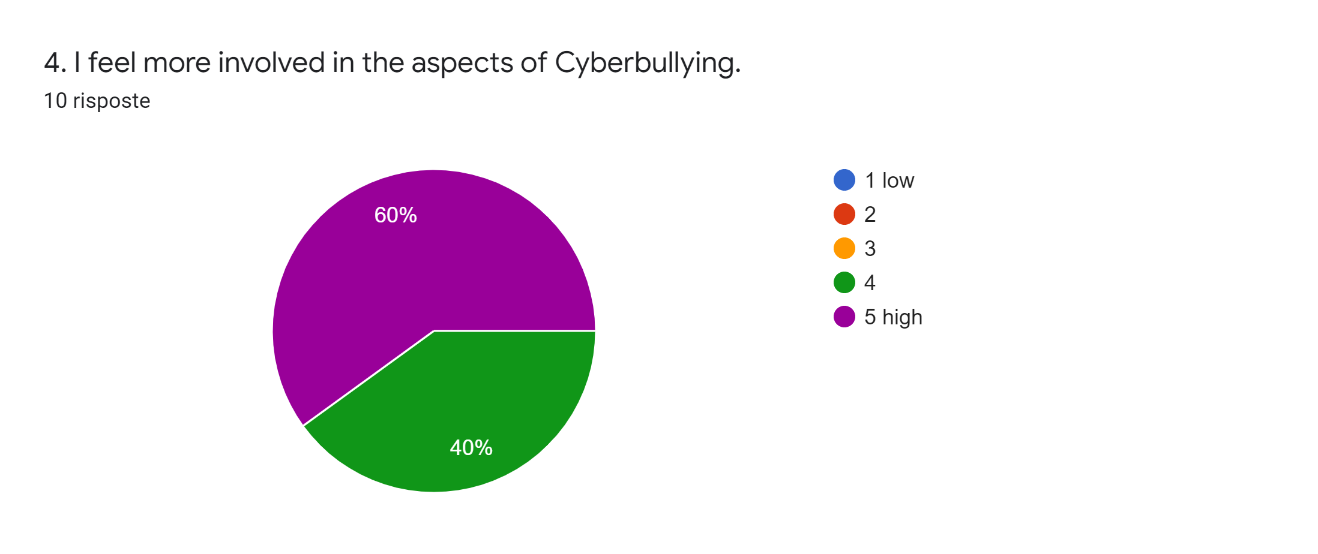

Slide 7
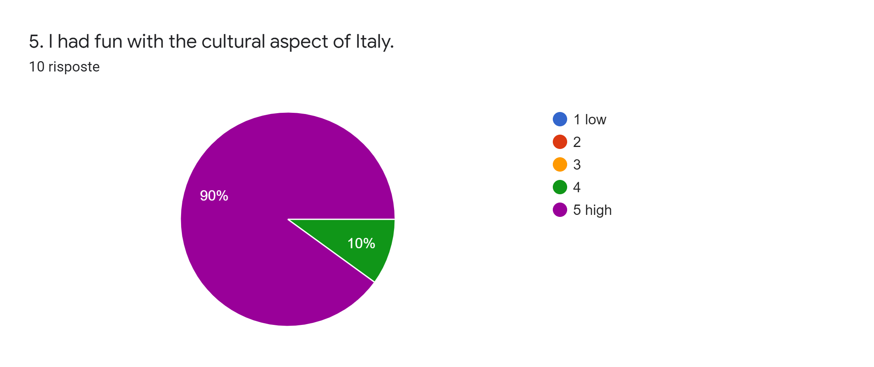

Slide 8
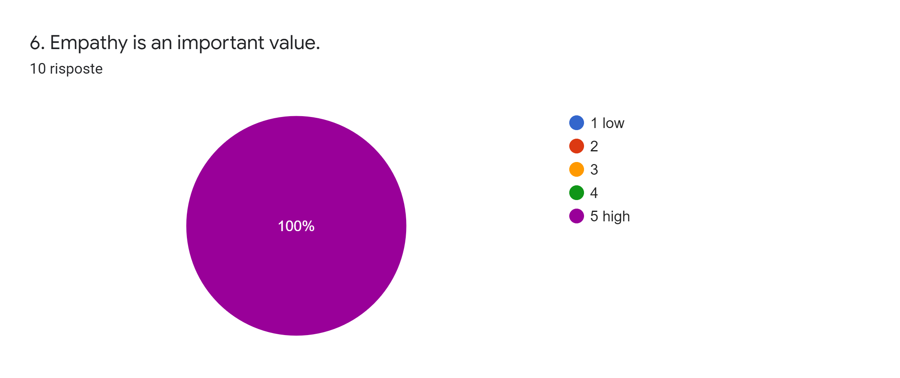

Slide 9
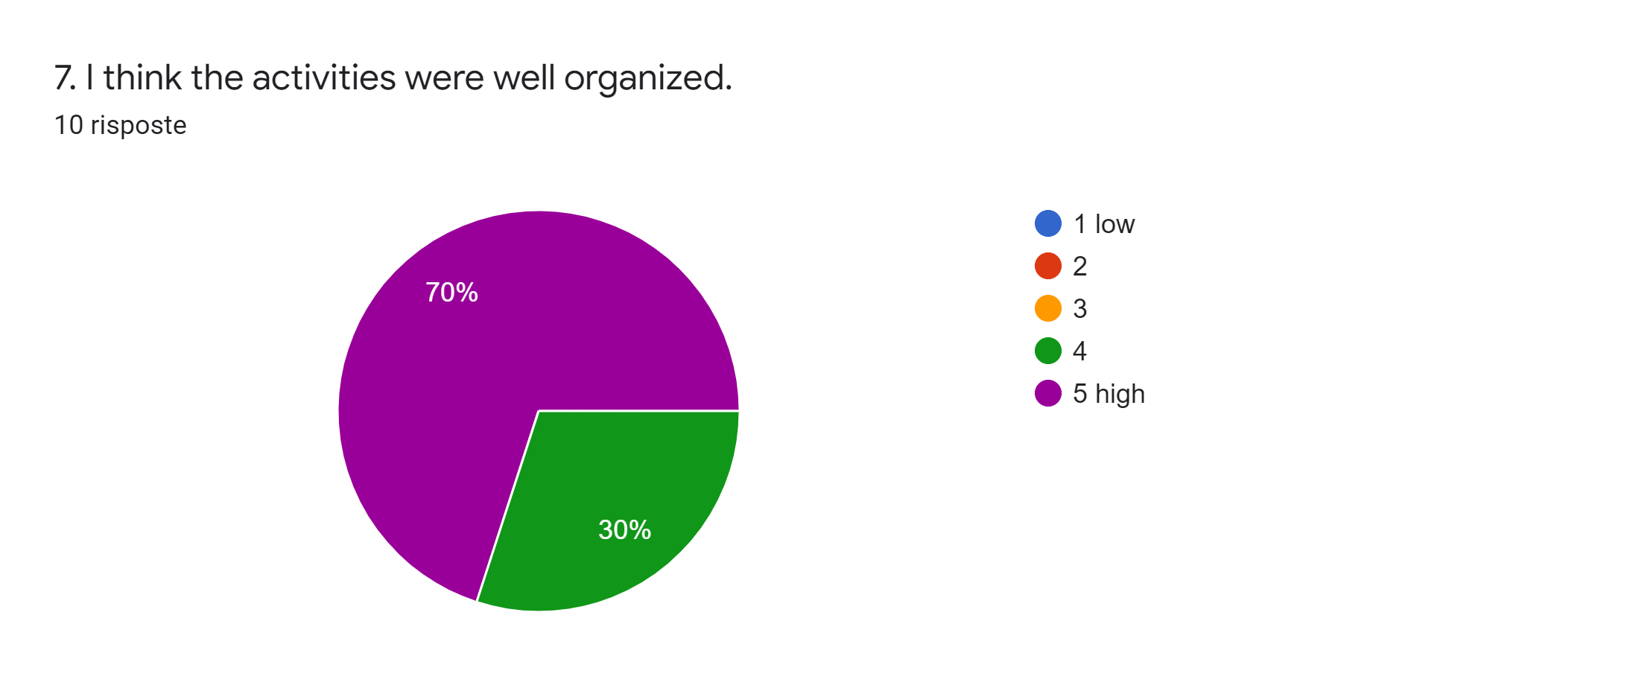

Slide 12
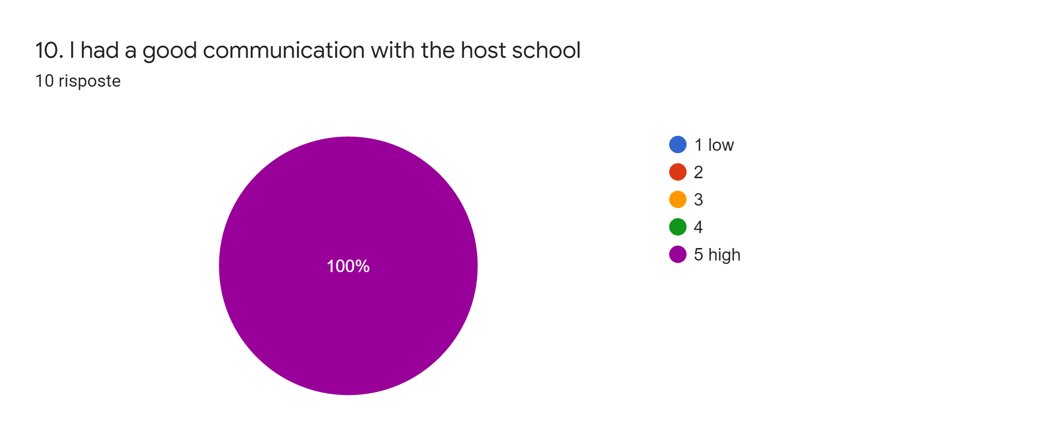

Slide 13
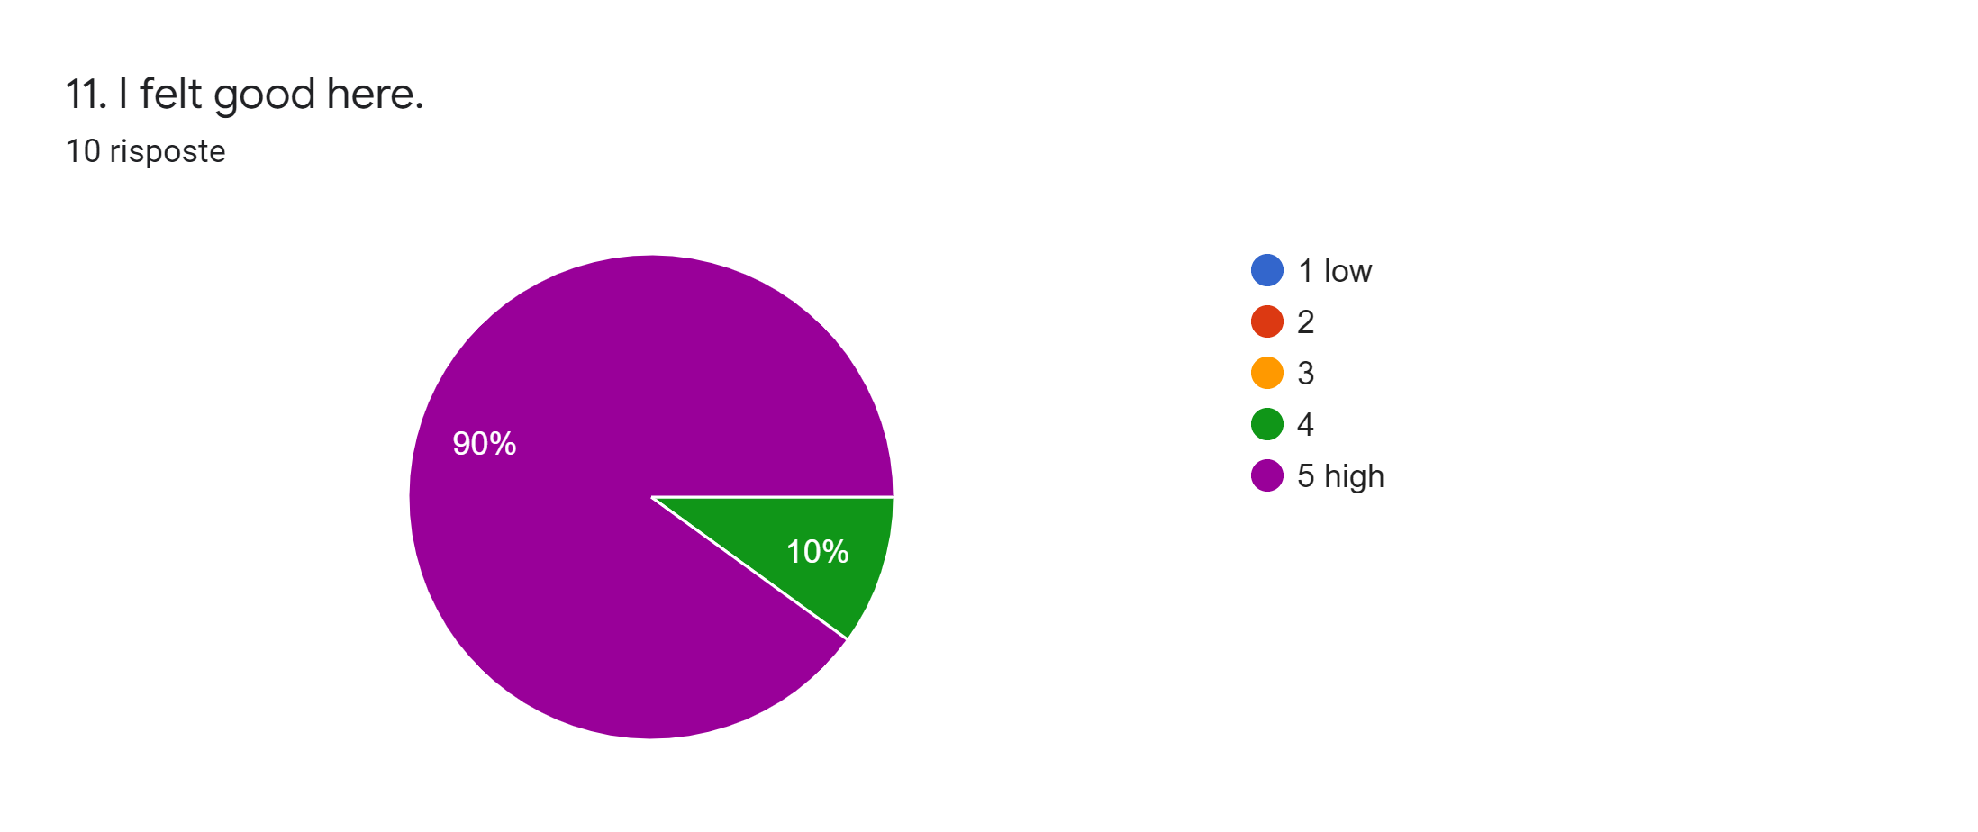

Slide 14
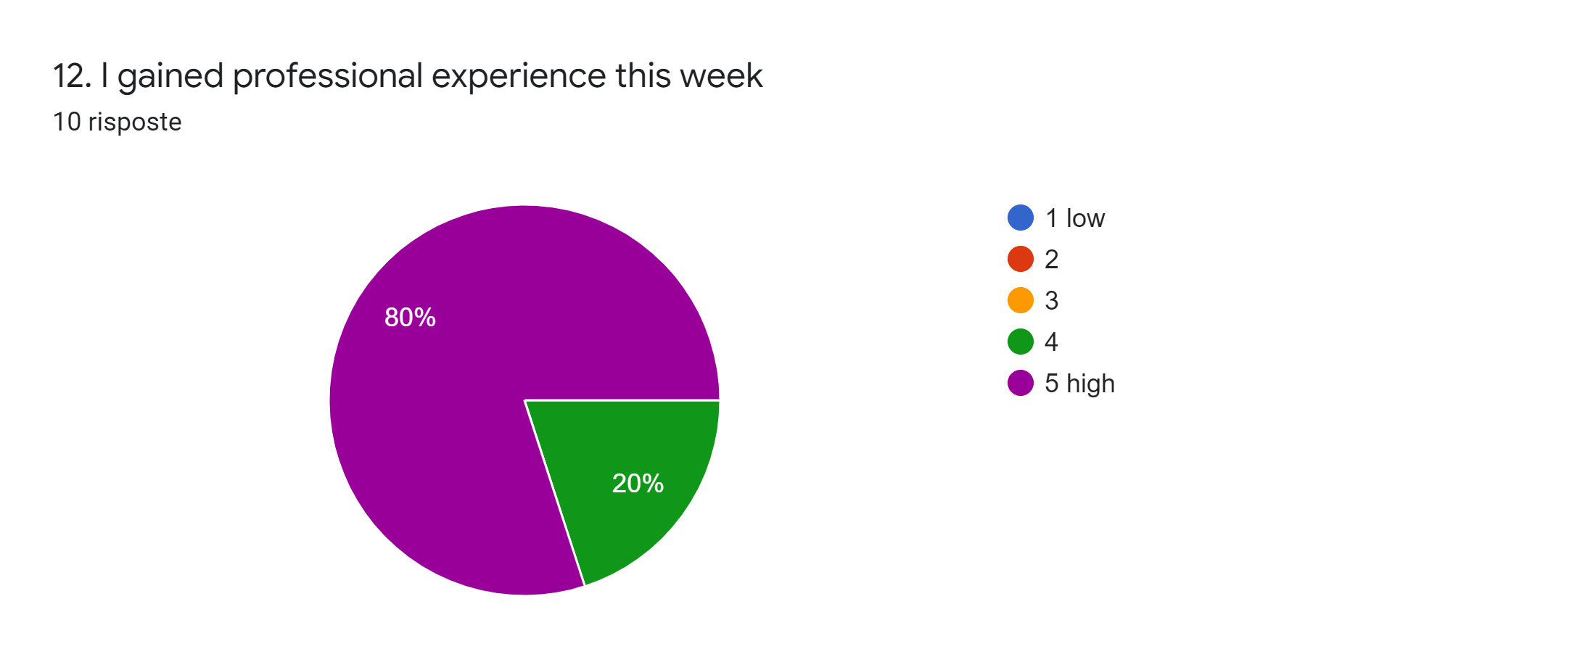

Slide 16
14. What was the best thing you had in our country?10 risposte
Asisi San Francisco
Your warmest welcome, amazing hospitality, excellent organisation!
The best thing I had was the interaction with all, teachers and students. The country is beautiful, which isn't new for me, but we were shown things that normally we wouldn't visit in a normal tourist trip. Todi was a big surprise, small but cozy and amazing. People were very kind. Assisi's monastery... no words to describe it. The most beautiful church I've ever seen. I will come back for sure.
Visiring
The travel to Assisi
This experience I had in your country, which has traces of history all around, was excellent. Culturally, I had a very valuable time.
The history of ItalyI think the best thing we have in each mobility is always the way students interact, learn and grow by exploring another conception of education and becoming citizen of the world, like Sócrates used to defend.
Hard to say only one ... Food, people, landscapes, guided tours ...
I was really impressed by the warmth and hospitality of the Italian school, teachers and students. I felt welcomed. The activities were very well organised which facilitated the communication between participants and the exchange of good practice. Congratulations to all Italian teachers and students. Many thanks for everything!

Slide 17
CONCLUSION
THE RESULTS GIVEN BY THE TEACHERS PRESENT TO THE MEETING WERE VERY GOOD AS PER GRAPHICS ABOVE

