Slide 1
P20 – report on the impact of the project
EUROPEAN SCHOOLS STAND AGAINST BULLYING
2019-1-RO01-KA229-063119

Slide 2
GENERAL INFORMATION
APPLICATION PERIOD : MAY - JUNE 2022
- EVALUATED PERIOD: SEPTEMBER 2019 – JUNE 2022
4 QUESTIONNAIRES WERE CREATED BY THE COORDINATING SCHOOL: for participating students, for participating teachers, for school managers, for indirect participants (other teachers, students’ parents)
THE FORMAT OF THE QUESTIONNAIRES WAS ELECTRONIC (ONLINE)

Slide 3
NUMBER OF RESPONDENTS;
EVALUATED AREAS
01-
97 STUDENTS
The impact of the project on 2 areas: bullying phenomenon and personal development
02
- 58 TEACHERS
The impact of the project on 2 areas: bullying phenomenon and personal and professional development
03
- 10 SCHOOL MANAGERS
The impact of the project on 2 areas: general perspective and strengthening organizational culture and its functioning
04
- 123 INDIRECT PARTICIPANTS
The impact and visibility of the project in the community

Slide 4
STUDENTS

Slide 5
The first question has a general aim: it refers to the extent the students feel the project general impact on them
64.9%
STRONG impact
23.7%
SIGNIFICANT impact
9.3%
MEDIUM impact
The first 2 categories of results sum 88.6%, which shows that there is very good perception of the project activities and impact in the majority of students.
CERTIFICATE

Slide 6
1) The bullying phenomenon (project’s main topic) – multiple choices
EMOTIONAL DEVELOPMENT – the capacity of understanding the feelings related to bullying
PRACTICAL ACQUISITION – the capacity to intervene efficiently in a bullying situation
AWARENESS OF POSSIBILITY TO PREVENT / STOP THE BULLYING PHENOMENON
NEW COGNITIVE ACQUISITION

Slide 7
CONCLUSIONS
The answers show clearly that students feel they have a much better understanding of bullying due to the project’s activities.
The answers in the lower part of the scale are almost non-existent.

Slide 8
2) Personal development – multiple choice
Increasing self-esteem – 89.7% choose YES, only 9.3% choose PARTIALLY
Improving communication with their peers – 92.8% choose YES, 7.2% choose PARTIALLY or NO
Improving communication with teachers – 93.8% choose YES, 6.2% choose PARTIALLY or NO
Stimulating creativity through the project activities– 56.7% choose GREATLY, 33% choose A LOT. Only 10.3% choose LITTLE
Improving English language skills– 89.7% choose A LOT, 8.2% choose LITTLE, 2.1% choose NOT AT ALL
Improving digital skills – 47.4% choose VERY WELL, 41.2% choose WELL, 10.3% choose SATISFYING
Personal contribution to the project – 72.2% choose VERY GOOD, 24.7% choose GOOD, 3.1% choose SATISFYING

Slide 9
CONCLUSIONS
The answers show clearly a positive contribution of the project to students’ personal development;
Almost all participating students benefited from the project activities a great deal.

Slide 10
Teachers

Slide 11
1) The bullying phenomenon (project’s main topic) – possible choices YES, NO, PARTIALLY
EMOTIONAL ACQUISITION - capacity to connect with the students involved in bullying situations
PRACTICAL ACQUISITION – new strategies to prevent a bullying situation
PRACTICAL ACQUISITION – new strategies to intervene in a bullying situation
NEW COGNITIVE ACQUISITION
 | 86.2% choose YES
 | 13.8% choose PARTIALLY
 | There are no answers for NO
 | 86.2% choose YES
 | 12.1% choose PARTIALLY
 | Only 1 respondent answer NO
 | 100% choose YES
 | 98.3% choose YES
 | Only 1 respondent answer NO

Slide 12
CONCLUSIONS
The answers show clearly that the project reached its objectives related to the “bullying” phenomenon at all levels – theoretical information, understanding the emotions involved, the capacity of preventing bullying situations and of intervening in a real bullying situation.
The answers of this first section correlates with the question formulated as a conclusion about the awareness of bullying and its consequences: 84.5% choose YES, 13.8% choose PARTIALLY and 1.7% (1 respondent) choose NO

Slide 13
2) Personal and professional development – marks from 1(very low) to 5 (very high)
Learning new teaching strategies and techniques
Getting professional experience
Contribution of project to personal development
65.5% - mark 5
17.2% - mark 4
The high scores sum a total of 82.7%
62.1% - mark 5
22.4% - mark 4
The high scores sum a total of 84.5%
67.2% - mark 5
22.4% - mark 4
The high scores sum a total of 89.6%
Reaching the personal aims set at the beginning of the project
Improving communication skills
Stimulating creativity
69% - mark 5
22.4% - mark 4
The high scores sum a total of 91.4%
There are only 5 answers for mark 3 and no answers for the lowest marks
72.4% - mark 5
15.5% - mark 4
The high scores sum a total of 87.9%
65.5% - mark 5
19% - mark 4
The high scores sum a total of 84%

Slide 14
CONCLUSIONS
The answers show clearly that the high scores appear as majority in all questions – an average of 80%, therefore the conclusion is that the project is successful
The participating teachers definitely feel that the project had a positive contribution to their personal and professional development

Slide 15
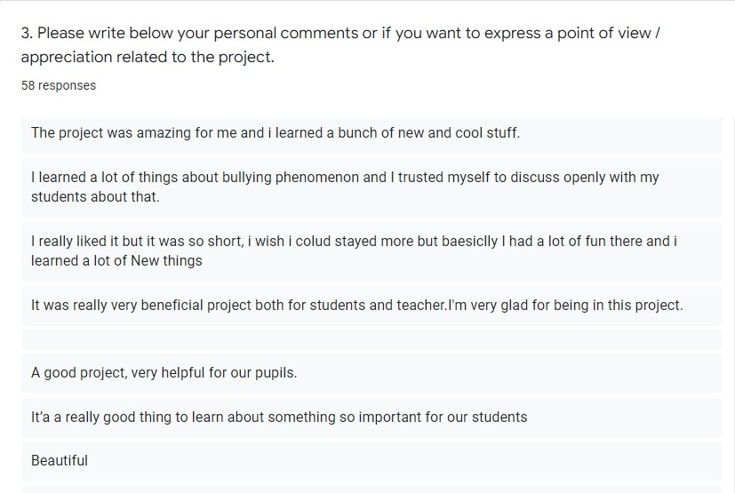
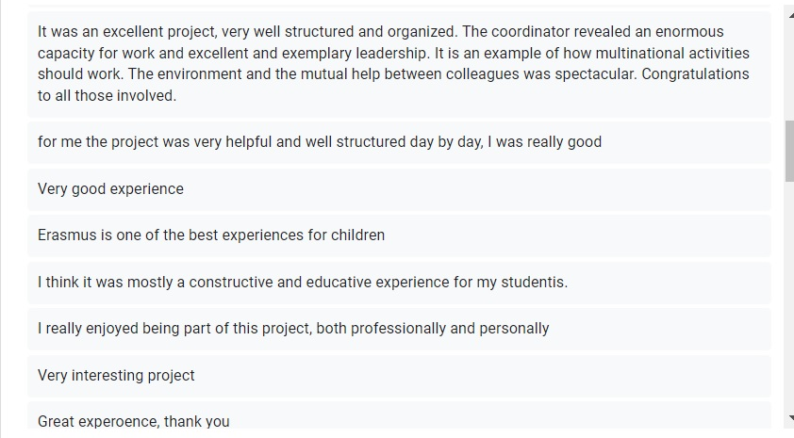
3) Teachers’ opinions
The last question refers to the project as a whole. Here, the respondents could express their ideas
The answers vary but they are 100% positive. There are general comments such as: a very good project, useful activities, an interesting topic, a wonderful experience, etc. There are also answers referring to a particular aspect of the project, such as: very good management, a lot of useful information, very good relationship between partners – students or teachers, appreciations related to the general coordination, etc.
There is on respondent who declared he/she did not like the project as the theme was not in his/her interests.

Slide 16
SCHOOL MANAGERS

Slide 17
1) The general perspective upon the role of the project in the partner schools’ life – marks from 1(very low) to 5 (very high)
Question 1
100%
The whole school benefited from this project.
Question 2
Question 3
Question 4
The project has achieved its school-level goals.
90%
90% choose marks 5 and 4 and only 10% choose mark 3.
90%
The project had a good visibility in our school
90% choose mark 5 and only 10% choose mark 4
80%
The project enhanced the visibility of the school at the community level
80% choose mark 5 and 20% choose mark 4.

Slide 18
2) Strengthening organizational culture and its functioning – marks from 1(very low) to 5 (very high)
100%
The activities which were carried out increased the awareness of students and teachers about bullying.
The activities carried out have increased students’ interest regarding this type of projects.
100%
The activities carried out have increased teachers’ interest regarding this type of projects – 90% choose mark 5 and 10% choose mark 4
90%
90%
The activities improved the student-teacher relationship – 90% choose mark 5 and 10% choose mark 4
The activities improved the ability of students and teachers to work in a team
100%

Slide 19
CONCLUSIONS
The answers show clearly that the high scores (4 and 5) appear almost 100%. There are no answers with low marks (1 or 2), only one evaluation criterion receives mark 3 which is a medium mark.
The managers’ perception regarding the project impact is more than favorable. Each manager considers that this project had a positive influence on the school life and culture.

Slide 20
INDIRECT PARTICIPANTS
(other teachers, students’ parents)

Slide 21
The project’s impact and its visibility in the community
91.1%
89.4%
The respondent knows the topic of the project
The project had a good visibility
91.1% choose YES
8.9% choose SLIGHTLY or NO
89.4% choose YES
9.8% choose PARTIALLY
0.8% choose NO
85.4%
89.4%
The respondent noticed his/her child's / students' involvement in this project
The respondent had the opportunity to discuss about this project with his/her child / students/ my colleagues
85.4% choose YES
8.9% choose PARTIALLY
5.7% choose NO
89.4% choose YES
10.6% choose NO
93.5%
74%
The respondent was informed about the development of the project activities
The respondent visited the project website/ Facebook page or TWIN SPACE of the project
93.5% choose YES
6.5% choose SOMETIMES or NO
74% choose YES
26% choose NO

Slide 22
CONCLUSIONS
The answers show clearly that people who were not directly involved in the project have a good knowledge about its topic, its activities. They talked about it and learnt about its outcomes (digitally)
The project’s implementation was visible for a great number of people, not only for those directly involved in it.

Slide 23
The English version of the questionnaires and the presentation were made by
The questionnaires were created and the answers were interpreted by
Sorina Dumitrescu – teacher of Romanian language and literature in School no 51, Bucharest, Romania
- responsible of project evaluation in the project team
Claudia Putura– teacher of English in School no 51, Bucharest, Romania
- project coordinator
Alexandra Hansa – teacher of English in School no 51, Bucharest, Romania
- responsible of monitoring the project

Slide 24
THANK YOU
The European Commission's support for the production of this publication does not constitute an endorsement of the contents, which reflect the views only of the authors, and the Commission cannot be held responsible for any use which may be made of the information contained therein.

