Slide 1
EUROPEAN SCHOOLS STAND AGAINST BULLYING
REPORT on questionnaires’ results
P4
Sorina Dumitrescu – teacher of Romanian language and literature
- responsible with evaluation
Claudia Putura – English teacher
- project coordinator

Slide 2
Students
- period: October 2019
target group: 84 pupils classes 5 – 8 from the project team
format: online questionnaire
respondents: 38 ( 45,2%)
purposes: -it was used as an “introduction” in the project main topic
-to gather data about:
a) what our pupils know about “bullying”
b) if they experienced it
c) pupils’ emotional response and how they handle the situation

Slide 3
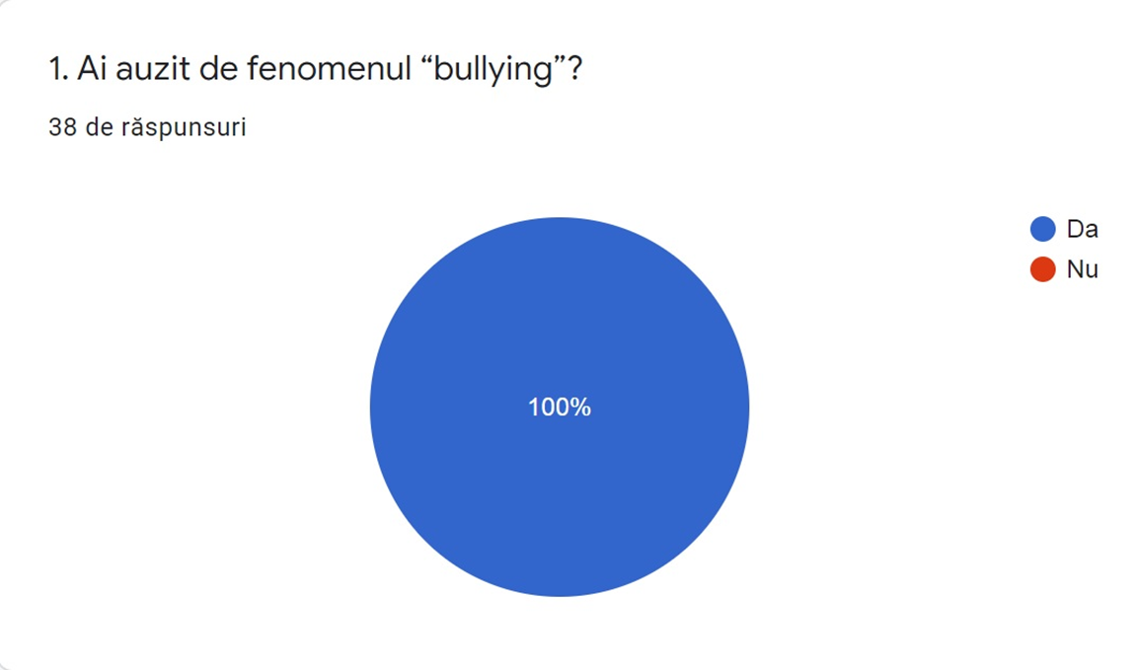
Question 1 – results:
100% have heard of this phenomenon which is a positive aspect as it means a good starting point of project’s activities

Slide 4
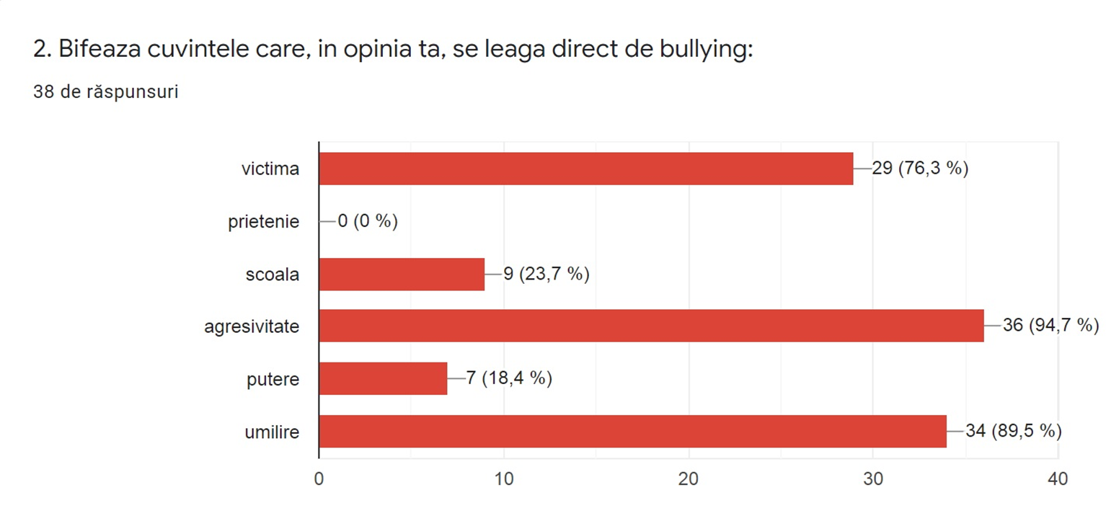
Question 2 – results:
87% of respondents associate bullying with “aggresivity”, “humiliation” and “victim” which means that they understand really well what this phenomenon is about

Slide 5
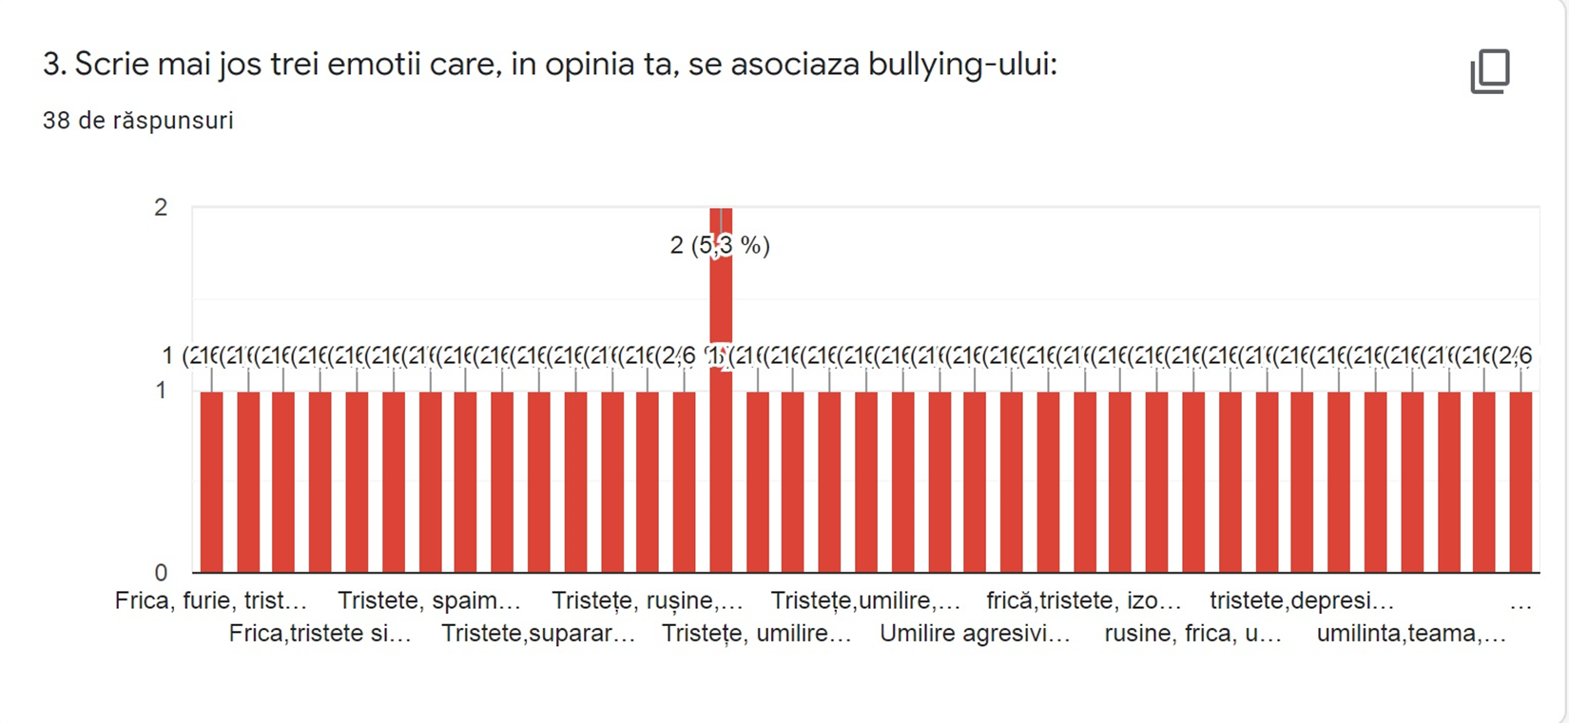
Question 3 – results:
The emotional response towards this phenomenon is structured on 3 coordinates which are interconnected: sadness, humiliation and fear. Other answers: shame, isolation, sufferance, depression.
Presentation
These answers mean that the respondents show empathy to the victim and they don’t channel their attention towards the aggressor/bully (there is “anger”, but in small percentage).

Slide 6
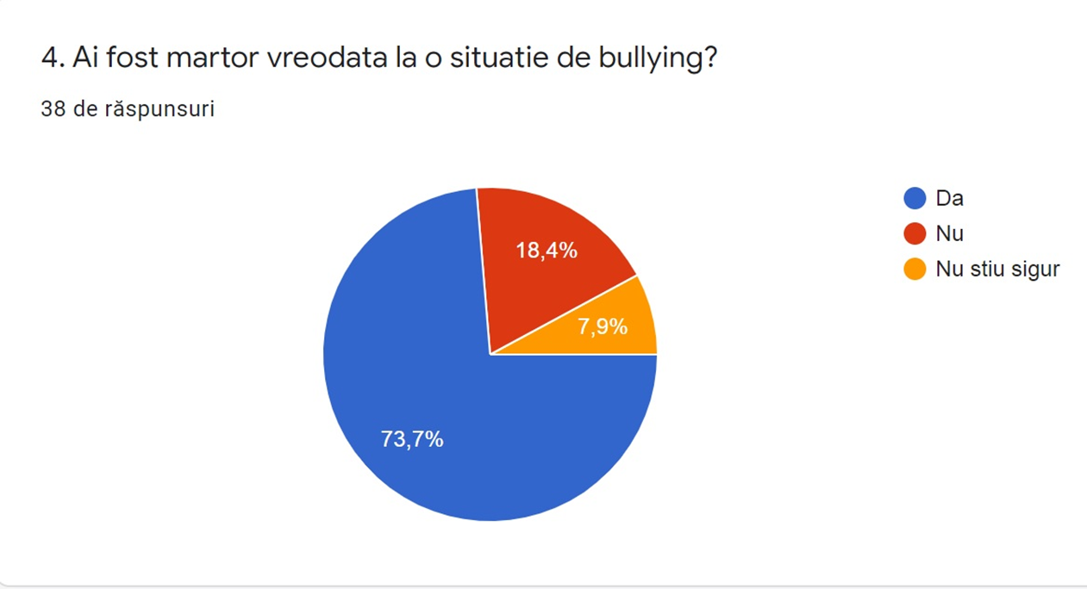
Question 4 – results:
74% of the respondents had direct contact with this phenomenon (this number shows the diffusion of it)

Slide 7
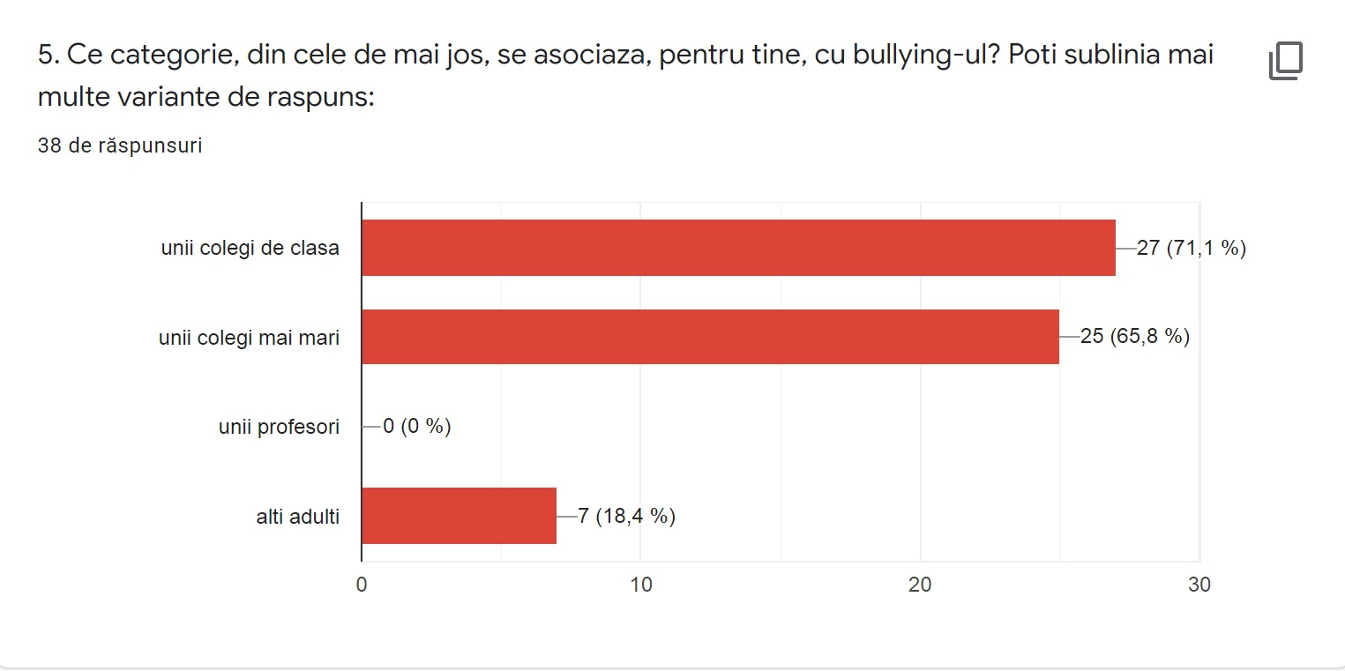
Question 5 – results:
the people who are indicated as being connected to bullying episodes are classmates (71%) or older students(66%). Only 18% of respondents mention adults, but nobody selected teachers for which there is no answer
Very interesting aspect: the data show that this phenomenon happens in the extended environment of school, pupils making a difference between the 2 realities.

Slide 8
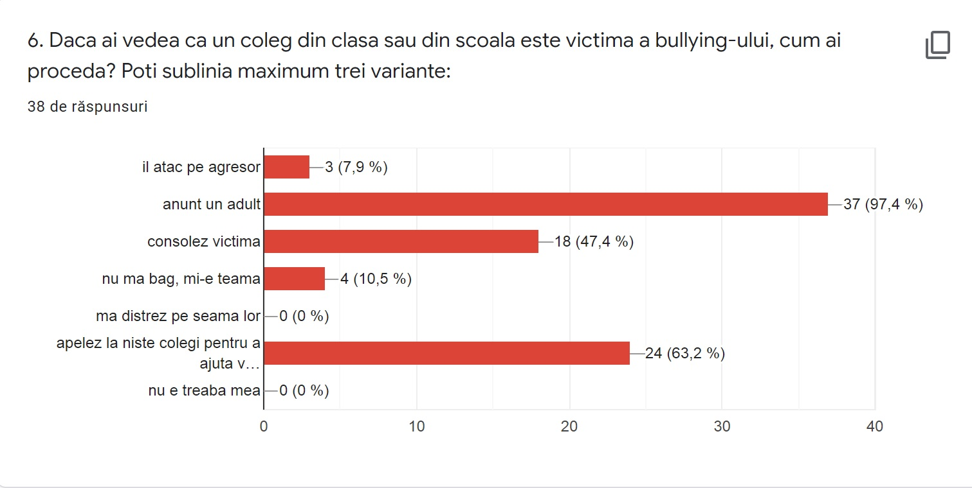
Question 6 – results:
As a possible direct intervention is announcing an adult (97%) or getting help from a colleague (63%), many students show empathy to the victim and support it emotionally (47%), and 8% would confront the bully directly. There is a small percentage of respondents who are afraid to intervene(10%), and there is no answer to show lack of involvement, indifference or carelessness.
This high percentage of pupils who would announce an adult is the signal that they seek for a real help from our part which is very normal and which forces us to look for realistic solutions to handle the bullying situations.

Slide 9
Teachers
period: October 2019
Target group: 42 teachers primary and secondary levels
respondents: 31 (73,8 %)
Format: online questionnaire
purpose: - to gather data about:
a) how familiar the teachers are with the “bullying” phenomenon
b) if they have ever encountered aspects of it
c) teachers’ emotional response towards it
d) how they perceive the relationship between their professional activity and bullying
e) what solutions they can find to handle a bullying event

Slide 10
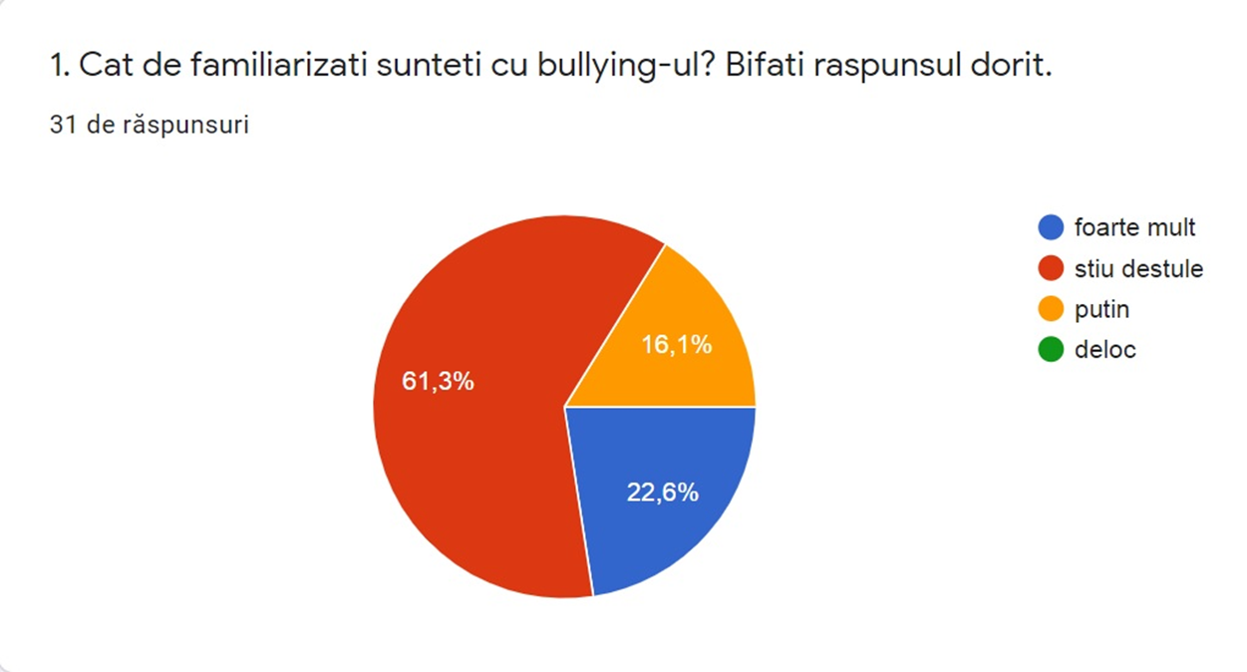
Question 1 – results:
The “bullying” phenomenon is well-known by 61%, a relatively small percentage (16%) admit having reduced information, and there is a considerable percentage (23%) of respondents who know a lot – which means there is enough informational potential in order to deepen the knowledge related to all the forms of bullying and to find solutions to reduce the bullying events.

Slide 11
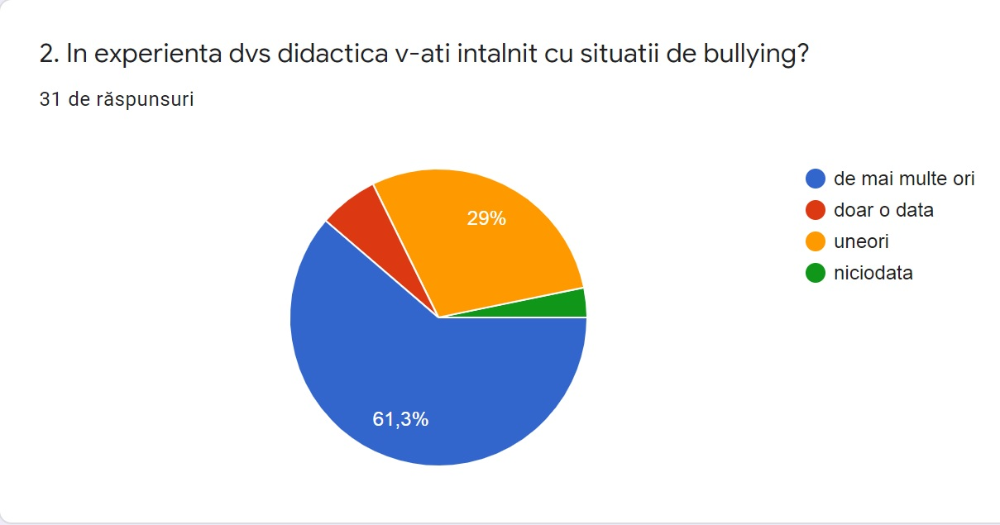
Question 2 – results:
90% of the respondents have encountered these situations, which means the knowledge is not only theoretical

Slide 12
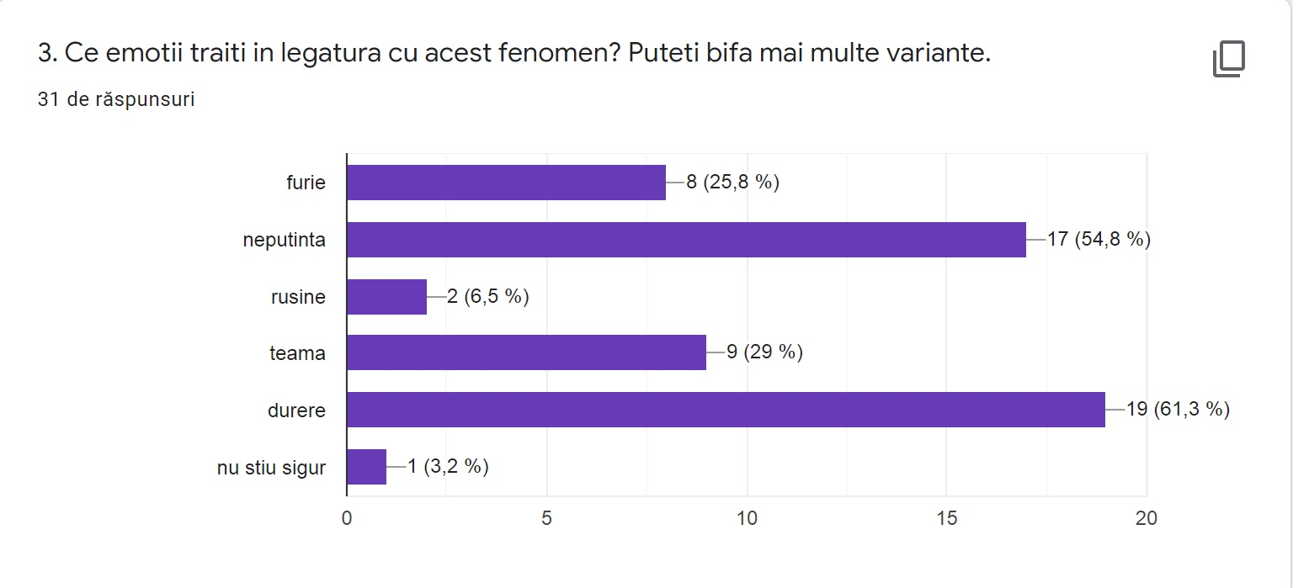
Like the pupils, teachers’ emotional answers relate either to the victim (bullied) or to the phenomenon itself: pain (61%), incapacity (55%), fear (29%), shame (7%). Anger - 26%.
Question 3 – results:
To be noticed the relatively high percentage of incapacity which shows teachers’ frustration: although they know the phenomenon and have met its forms, they still can’t find suitable solutions for it. These projects’ activities can be a starting point and a real help.

Slide 13
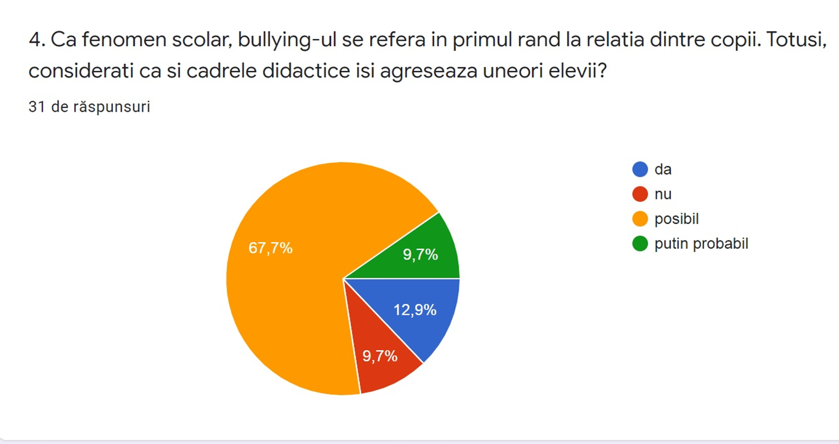
Question 4 – results:
Although the specialists show explicitly about the aggressive patterns in school environment which are among the situations that lead to bullying, teachers don’t understand it - 68% of the respondents say it is possible that some teachers attack their pupils, only 13% give an affirmative answer, while 10% totally rule out this possibility.

Slide 14
It is obvious that this aspect deserves more attention: it is almost impossible for teachers to fight this phenomenon if they themselves don’t understand their own attitude towards pupils. It is necessary for teachers to stop comparing pupils, using ironic or condescending voice/words, using scornful attitude, using fear as a way of intimidation and control. These behaviours are taken by possible bullies.

Slide 15
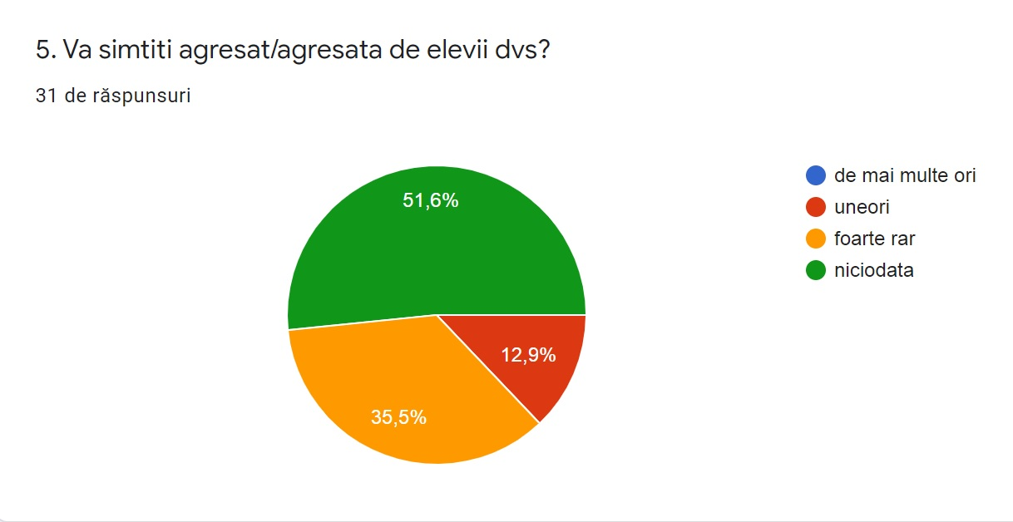
Question 5 – results:
More than half of the respondents (52%) state that they never feel bullied by pupils, 35% - very seldom, 13% - sometimes.
Considering the fact that pupils in gymnasium (especially pupils grades 7 and 8) can be very uncooperative, even hostile, the first percentage refer probably to the teachers in primary classes.

Slide 16
Question 6: Write down three aspects that, in your opinion, would be the cause of bullying.
Respondents have identified as causes of bullying:
Exposure to aggressive behavior (especially in family)
Reduced empathy
Lack of education (especially emotional education)
Frustrations (e.g. parents’ neglect)
Lack of affectivity in family
Absence of educational programs
aggressiveness in society in general

Slide 17
Question 7 - Please state your opinion on how you might intervene if you saw a bullying situation involving your students.
01
making pupils aware of the bullying forms through role play frontal discussions in counselling classes or in other occasions
02
Meetings with psychologists or school counselors who can give examples of best practice
03
Making the family aware
04
Showing motivational films, increasing pupils’ empathy

Slide 18
The variety of answers show the teachers’ interest and their preoccupation in finding solutions. There is an answer which is worth considering as it suggests that teachers do not have, yet, a protocol or an intervention scheme especially designed for it. The respondent says: “There are probably some ways to handle it according to the type of bullying.”

Slide 19
Education policy regarding BULLYING phenomenon in Romania
According to WHO – World Health Organisation, at European level, Romania is on 3rd place in a bullying top of 42 countries. Moreover, a national sociologic study made by the organisation SALVATI COPIII (Save the children) in 2016 revealed worrying numbers:
1 in 4 children is humiliated in school, in front of other colleagues;
1 in 5 children humiliates repeatedly another child at school;
3 in 10 children are repeatedly excluded from colleagues group;
1 in 6 children is repeatedly beaten;
7 in 10 children have witnessed a bullying event in school environment

Slide 20
In 2018, the Parliament adopted a law which modified the National Education Law no 1/2011, which acknowledged the existence of bullying phenomenon in schools and which defined it in terms of forms and effects of it.
At the beginning of 2019, the School Inspectorate of Bucharest together with the Police made a protocol of intervention in bullying situations. This was presented to all teachers in all schools in Bucharest.
Some ways of preventing or resolving it:
Bullied child should announce the class teacher/other teachers/ school principal
Class teacher organizes discussions school counsellor – class
School counsellor organizes discussions with bully’s/ bullied child’s parents and makes an intervention plan (only with parents’ agreement)
If the situation continues and/or the parents don’t agree with counselling, school announce the Child Protection or the Police
A school commission designed for this elaborates reports on violence cases in school and propose measures
if the case gets to Child Protection, they contact school for more details, guide the child (bully or bullied) towards a specially designed program (only with parents’ consent), mediate the relationship between school – family
According to the law, a minor becomes responsible for his/her acts at the age of 14 without being deprived of freedom
School should implement extra-curricular activities in association with NGOs in order to prevent this phenomenon

Slide 21
Thank You

