Slide 1
EUROPEAN SCHOOLS STAND AGAINST BULLYING
2019-1-RO01-KA229-063119_3
Activities evaluation questionnaire for pupils
(İzmir, 07/03/2022 – 11/03/2022)
Students-Evaluation

Slide 2
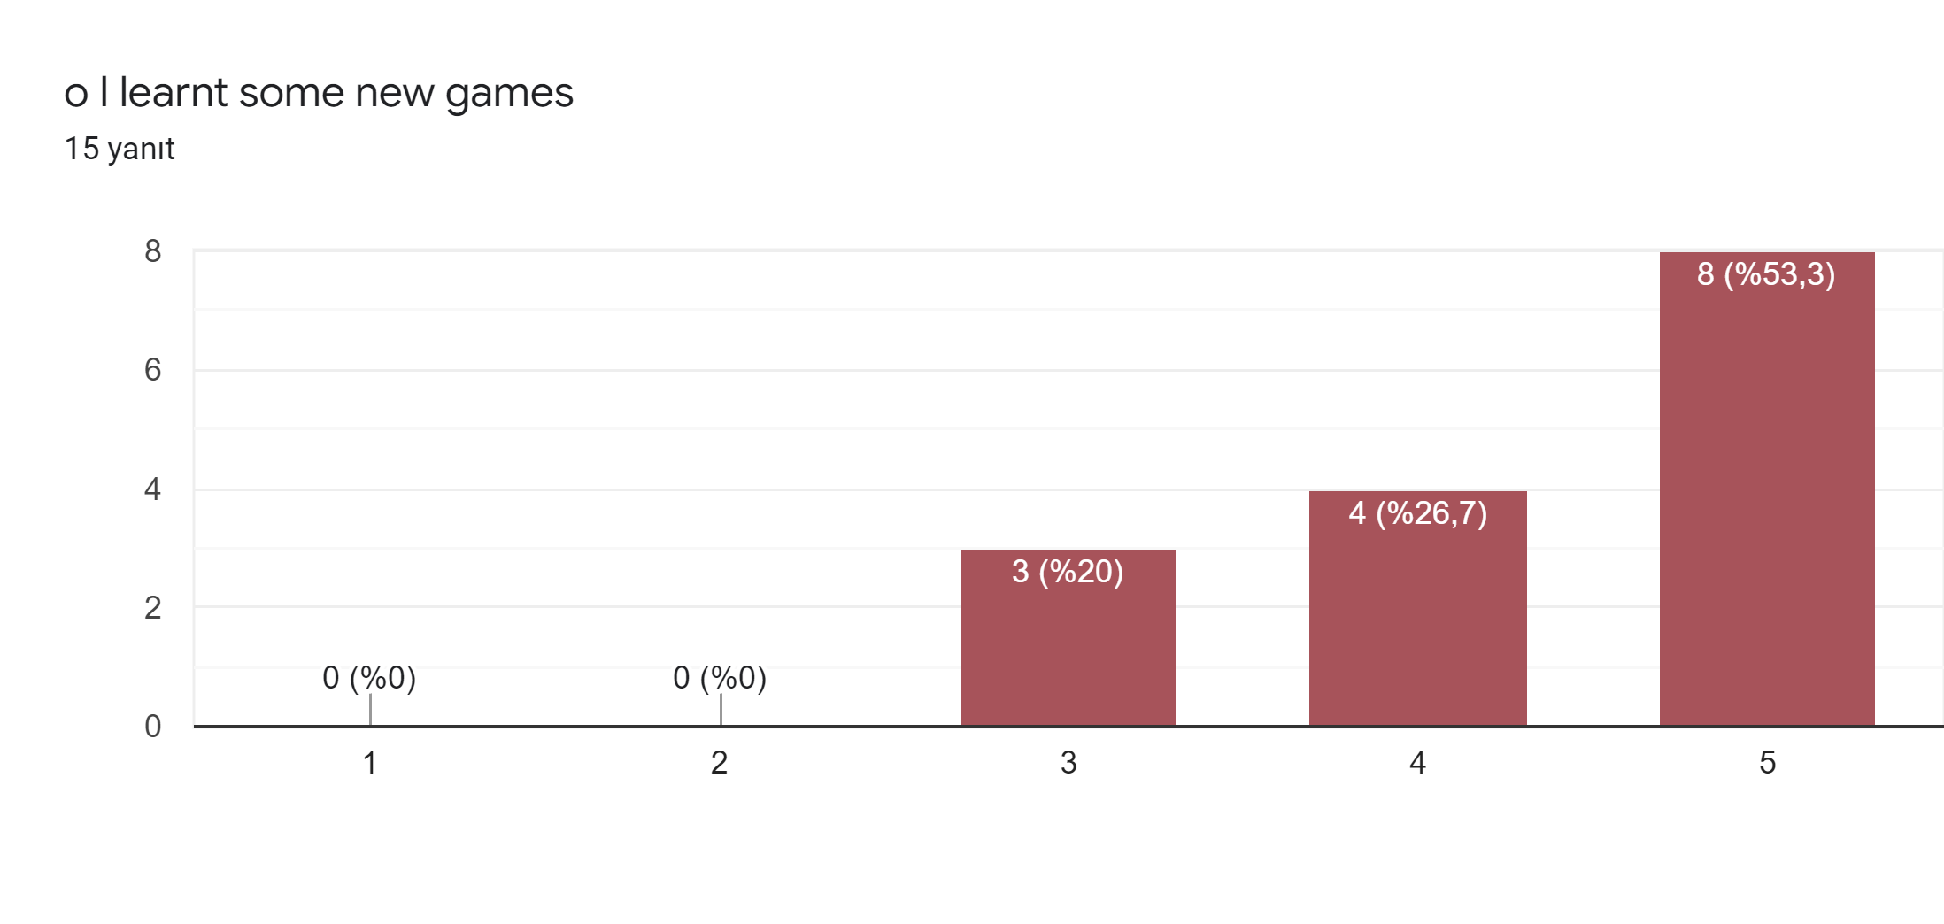
I. Ice-breaking games

Slide 3
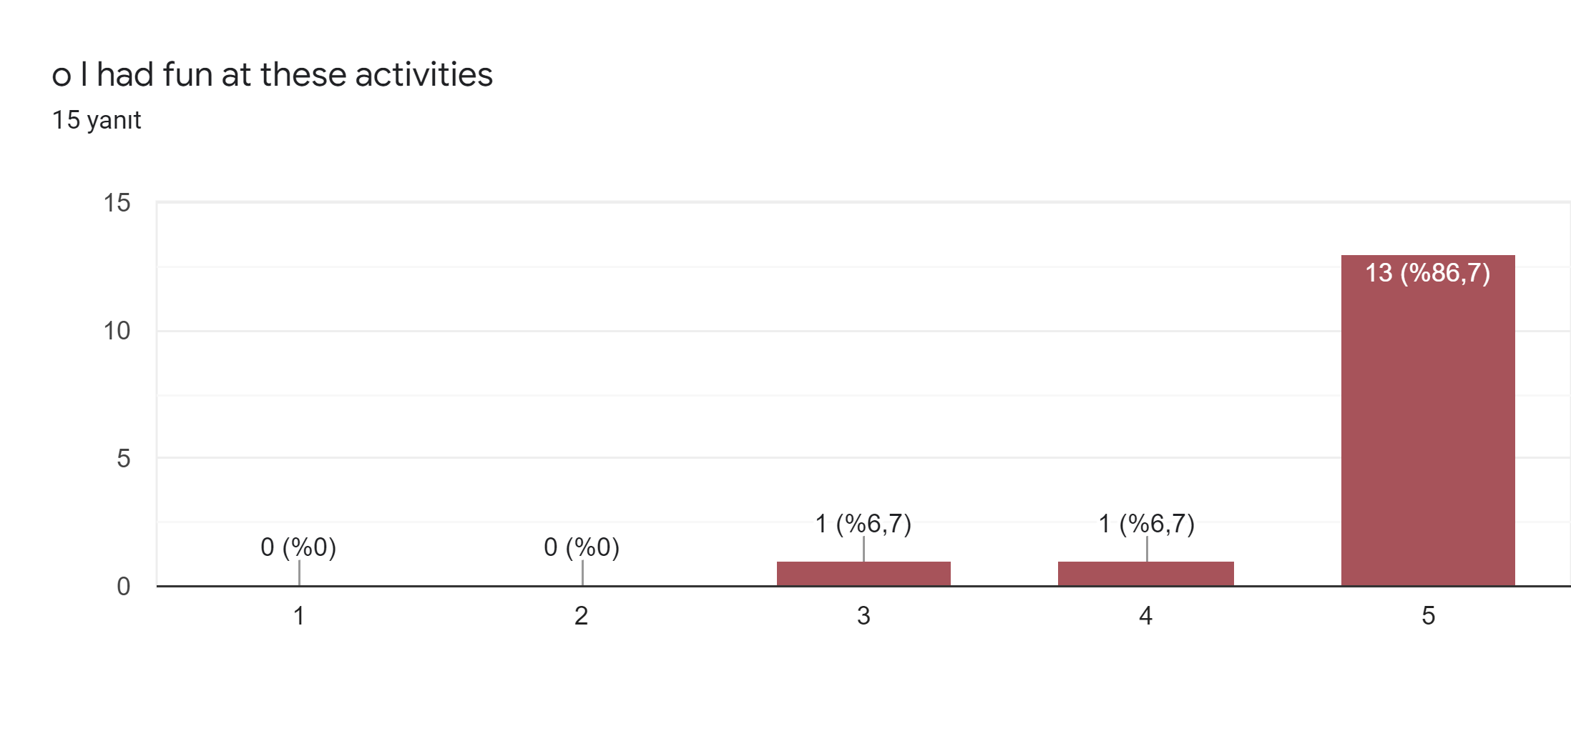

Slide 4
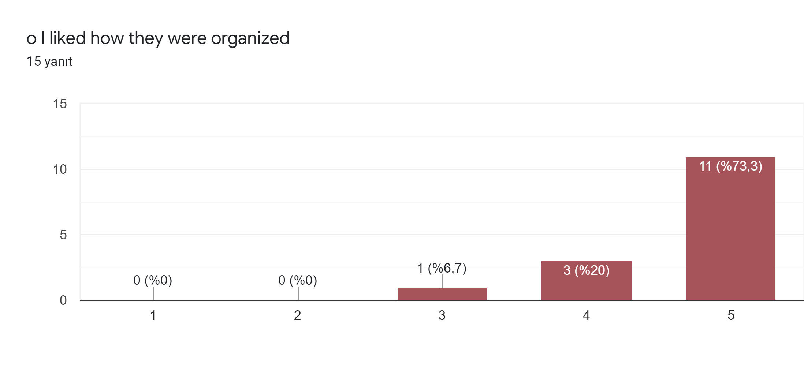

Slide 6
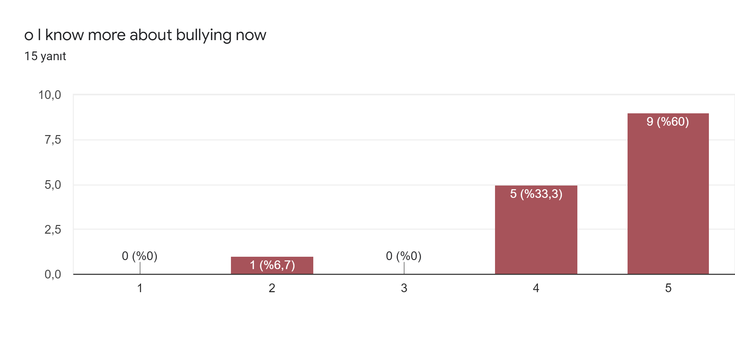
II. Change Y.W,Change Y.Relationship + Making the respect cardboard +Anti-bullying Activities and canva

Slide 7
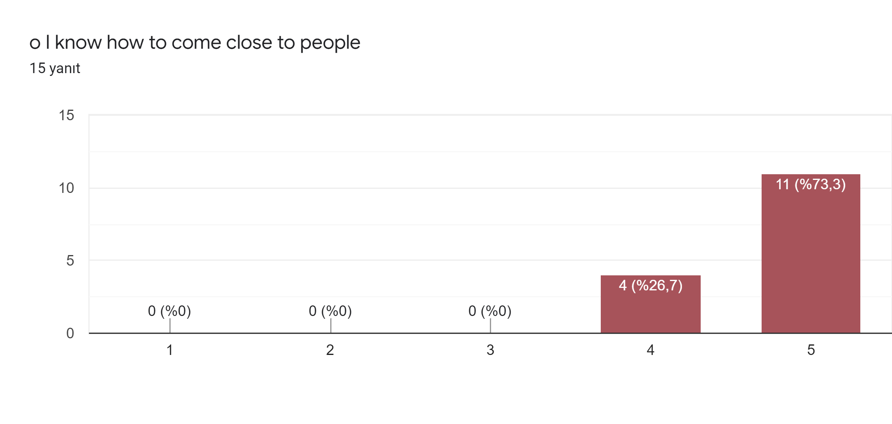

Slide 8
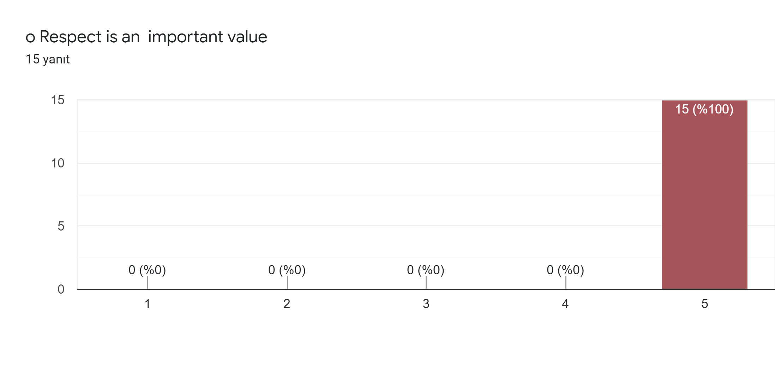

Slide 9
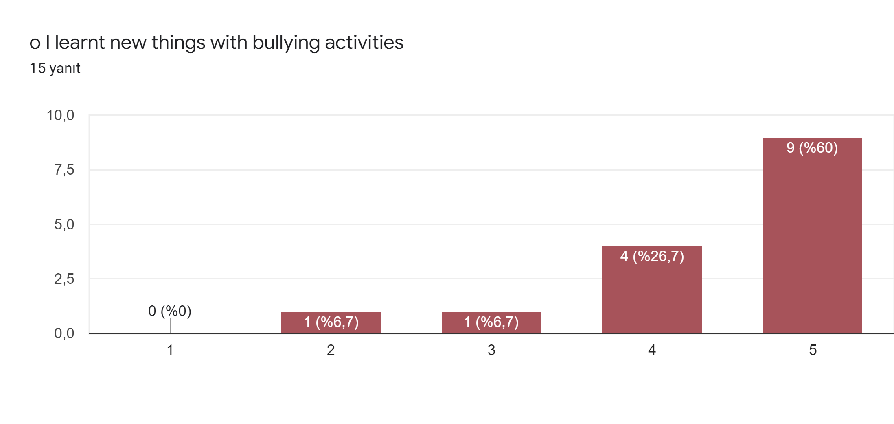

Slide 10
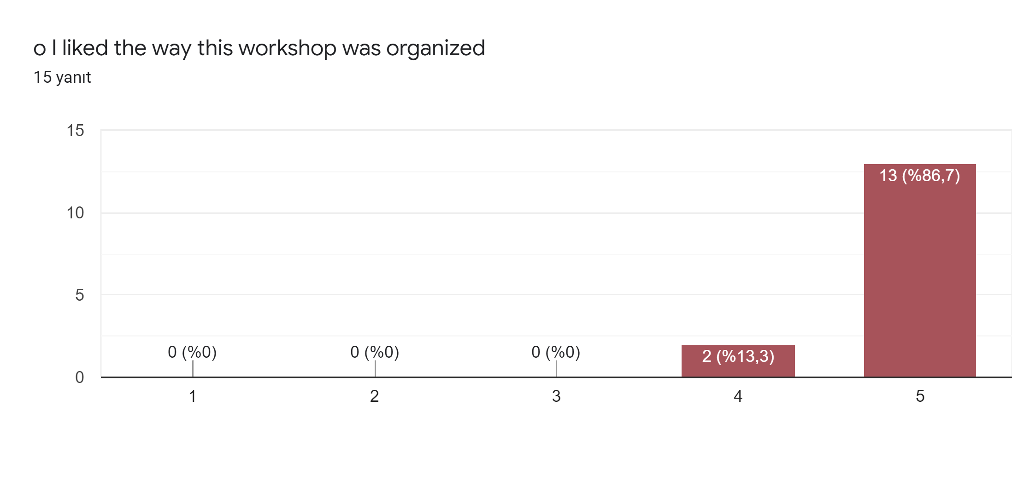

Slide 11
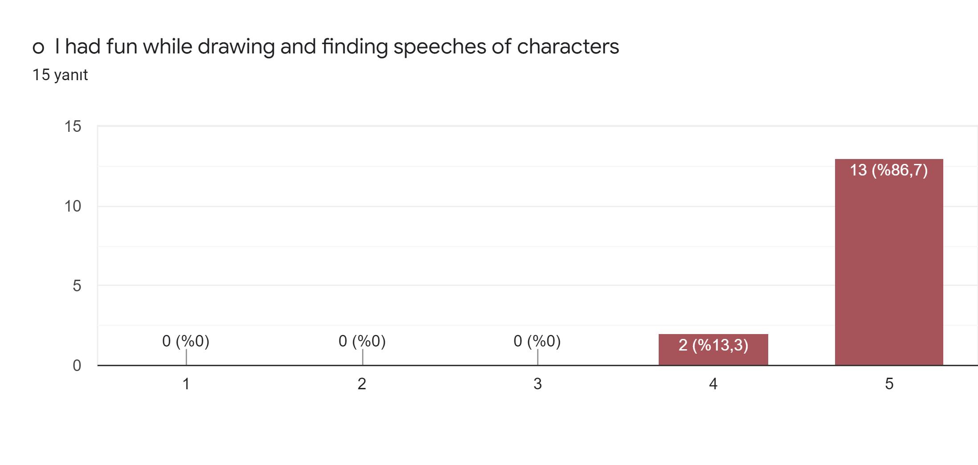
III. Workshop of magazine

Slide 12
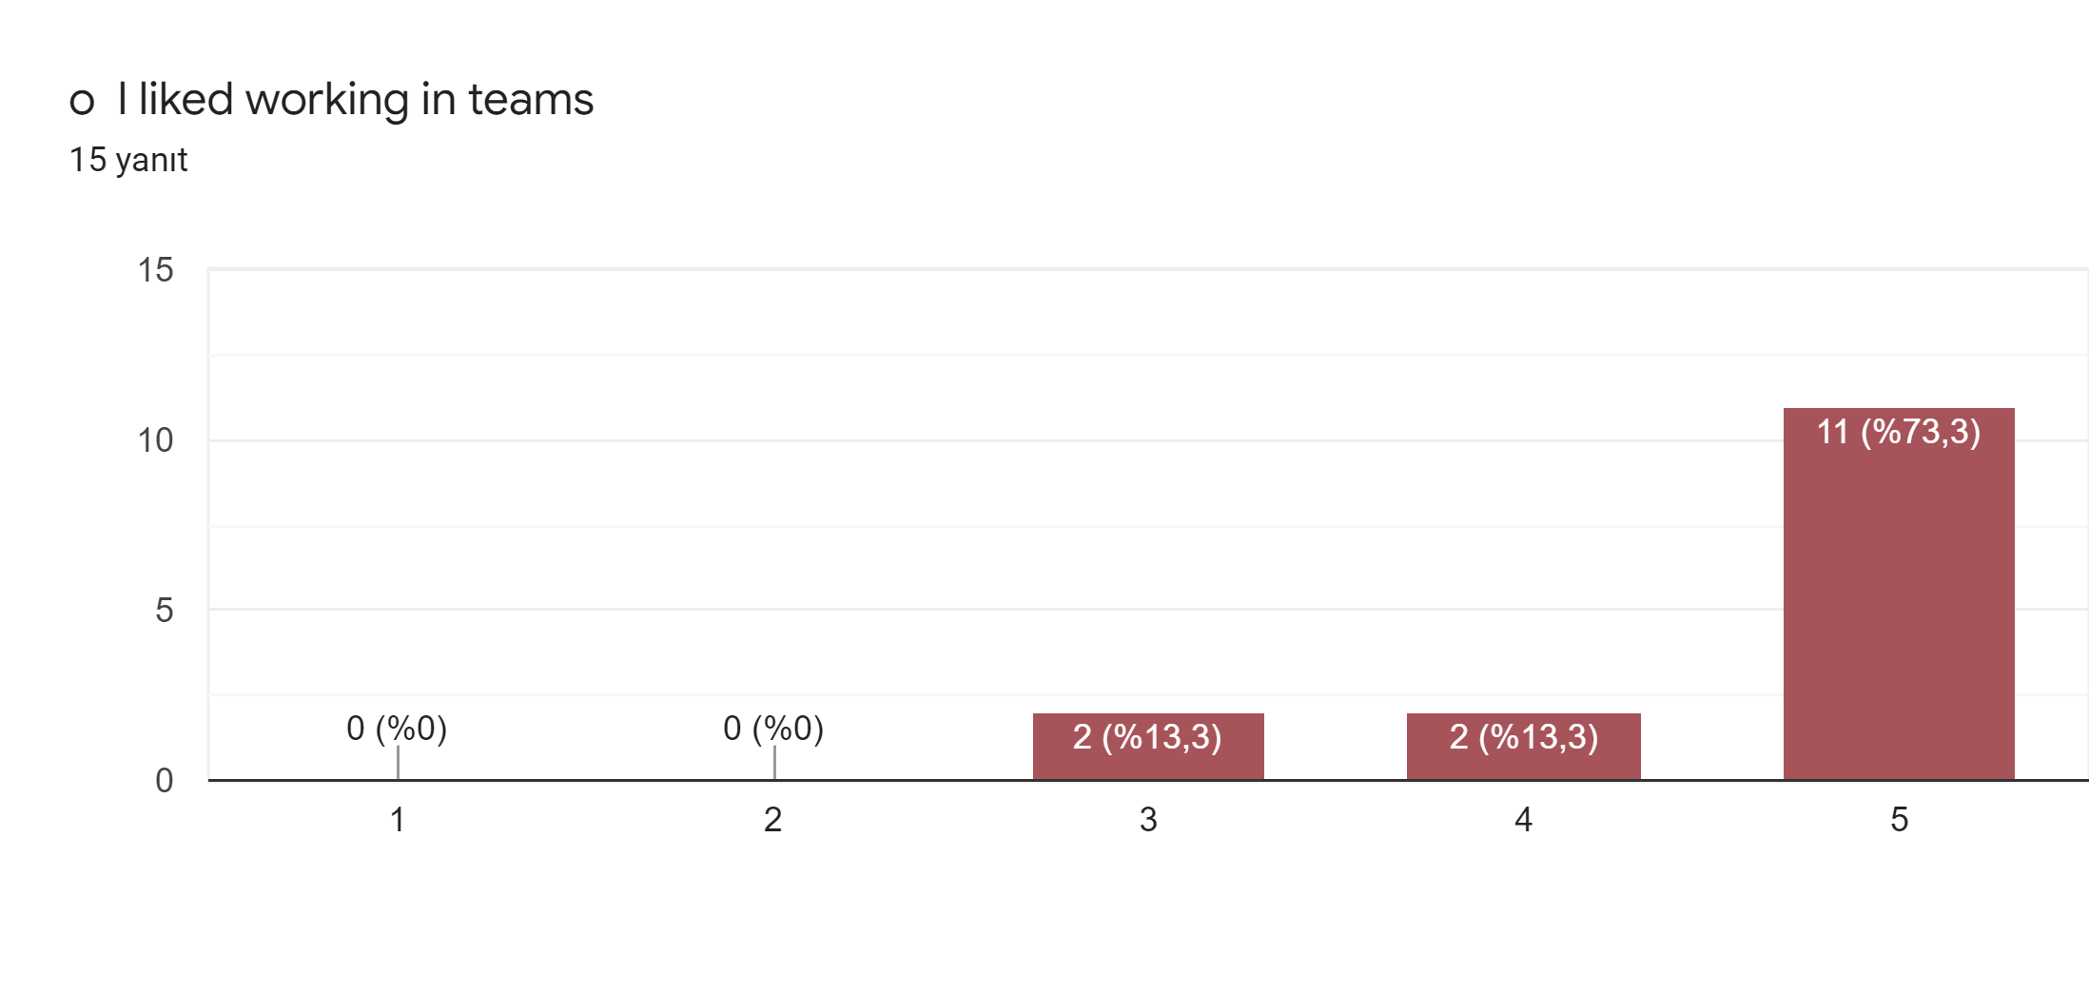

Slide 13
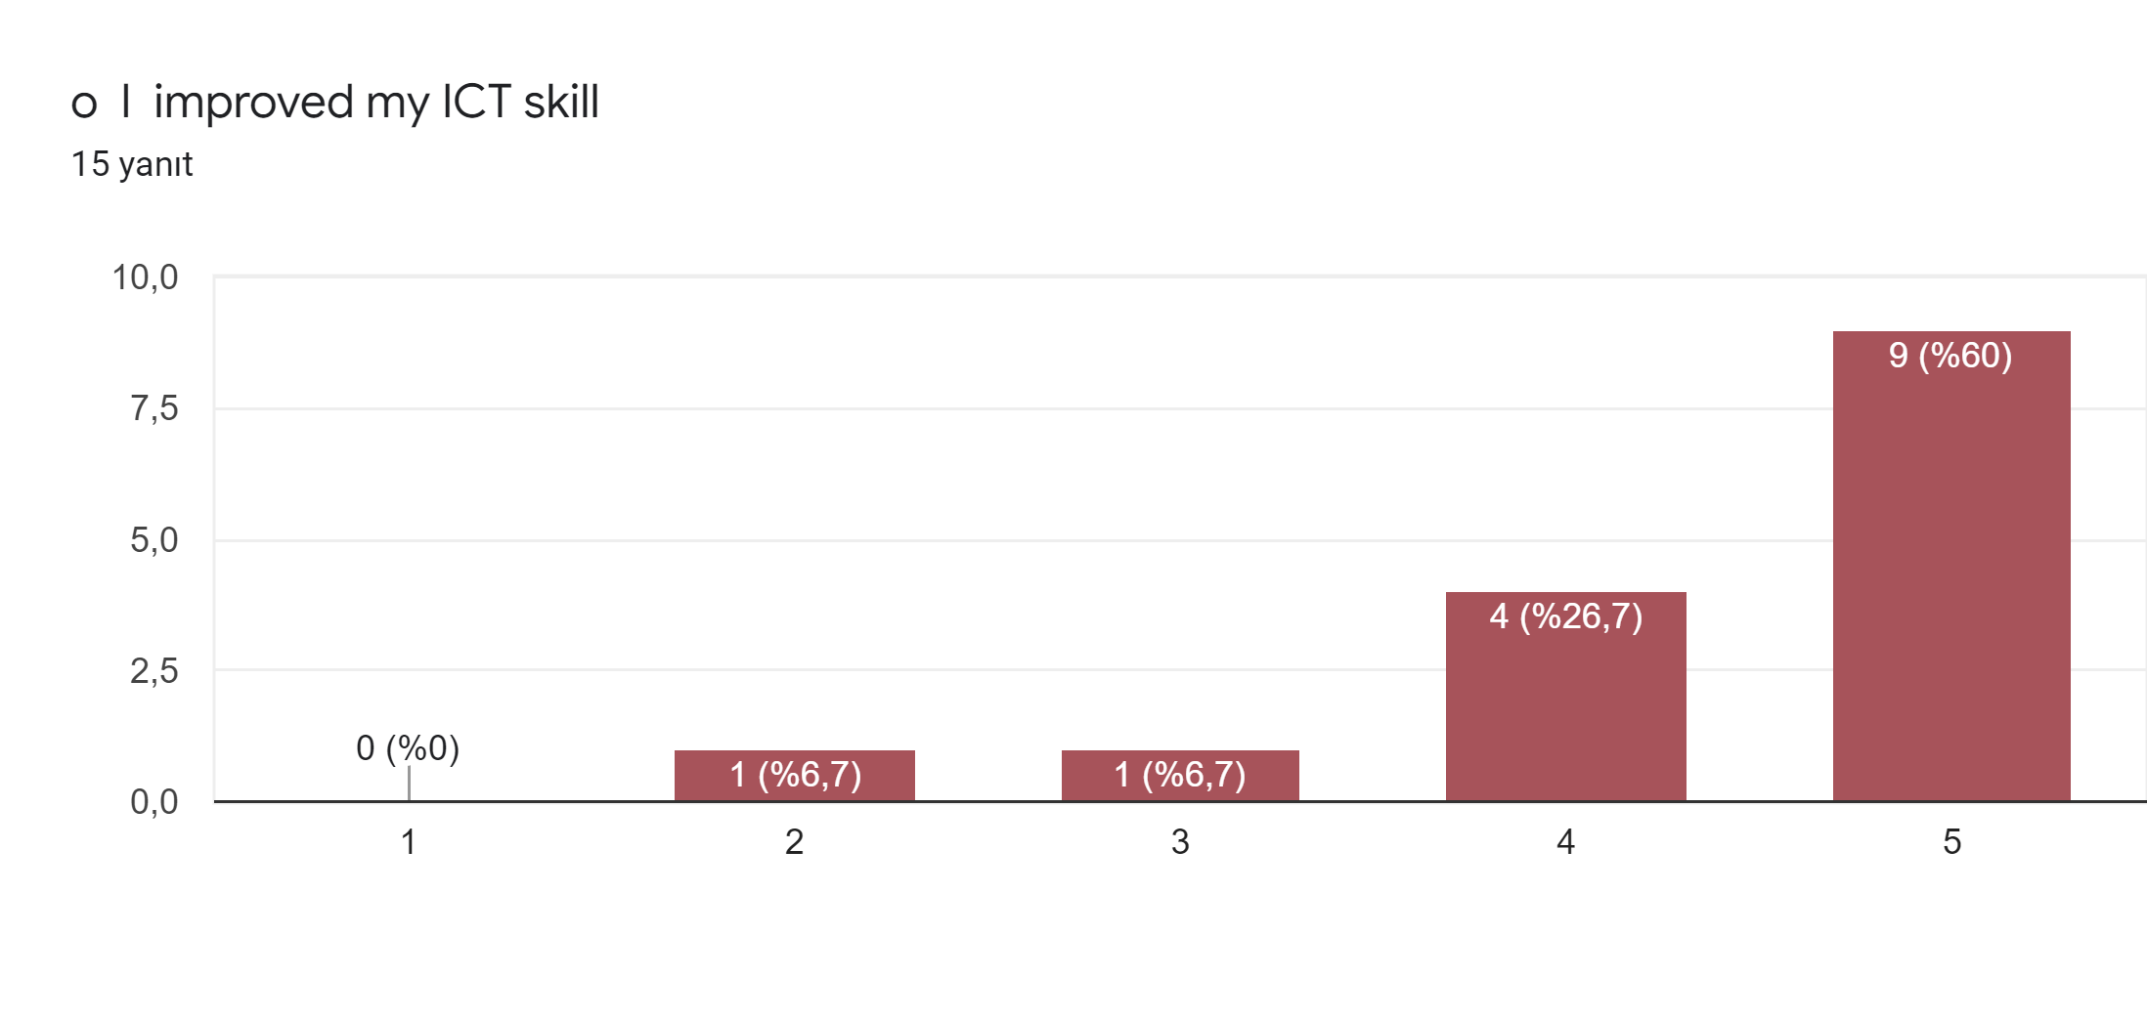

Slide 14
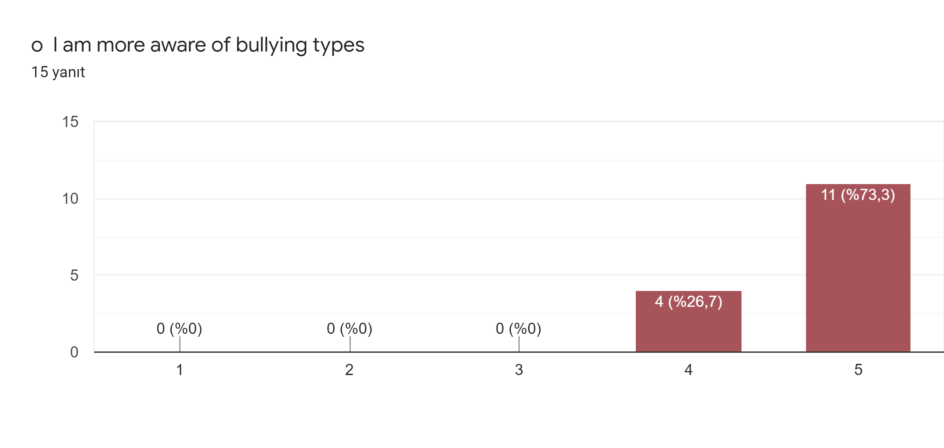

Slide 15
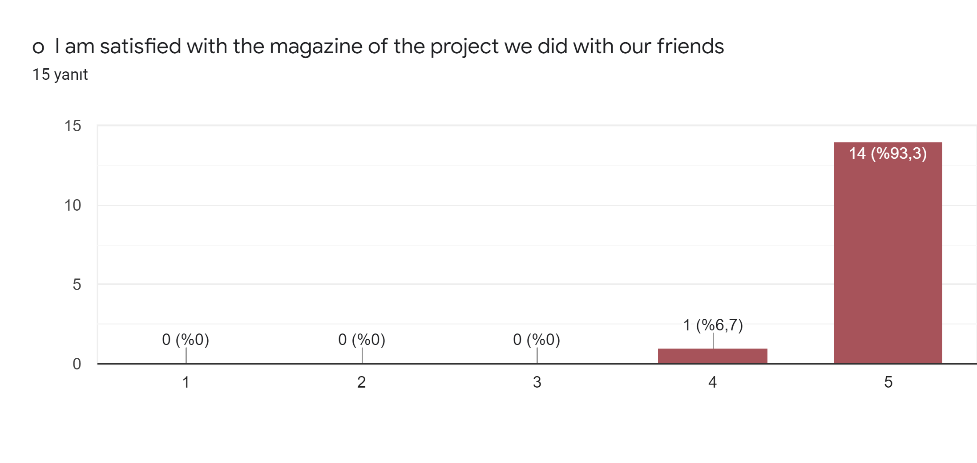

Slide 16
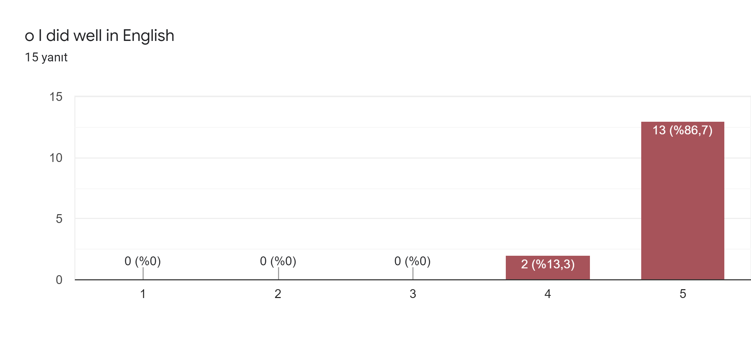

Slide 17
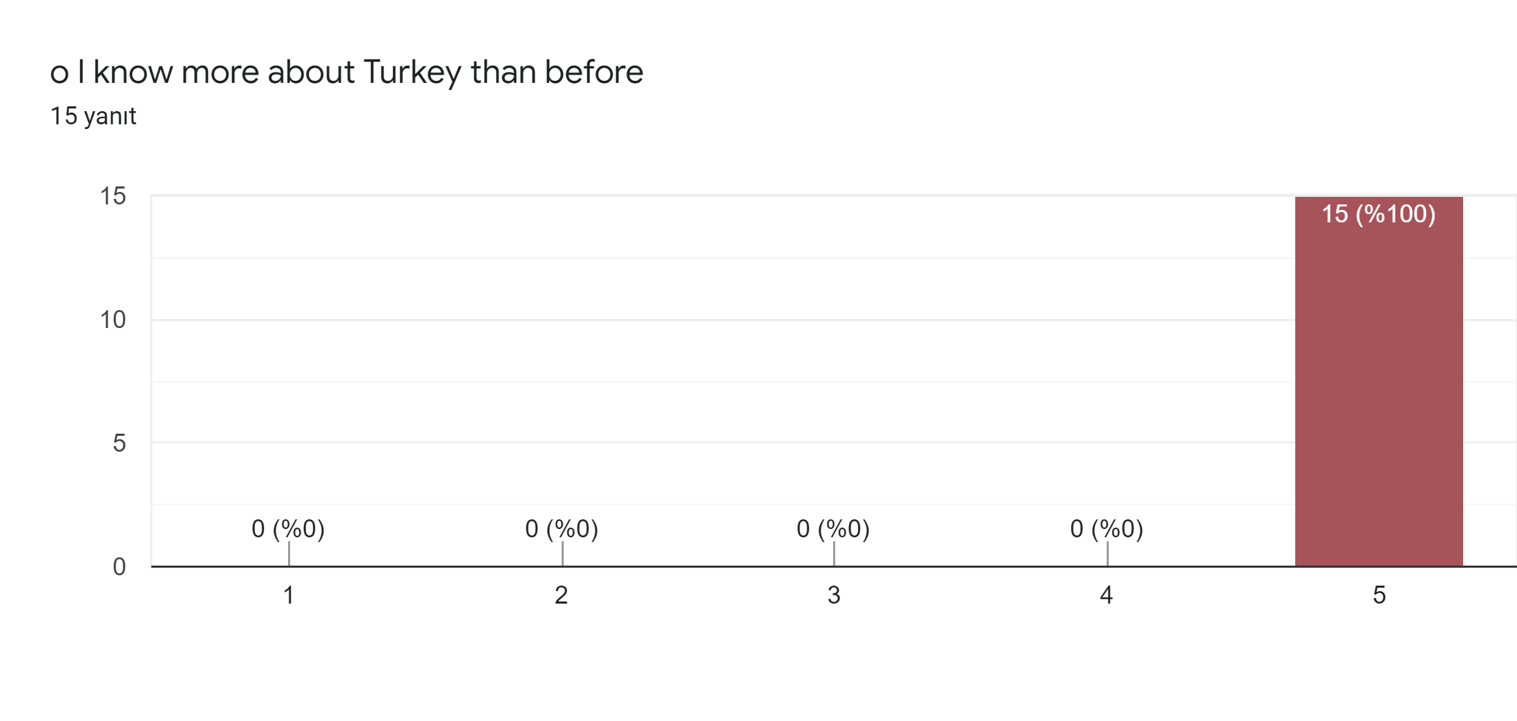
IV. Discover Turkey

Slide 19
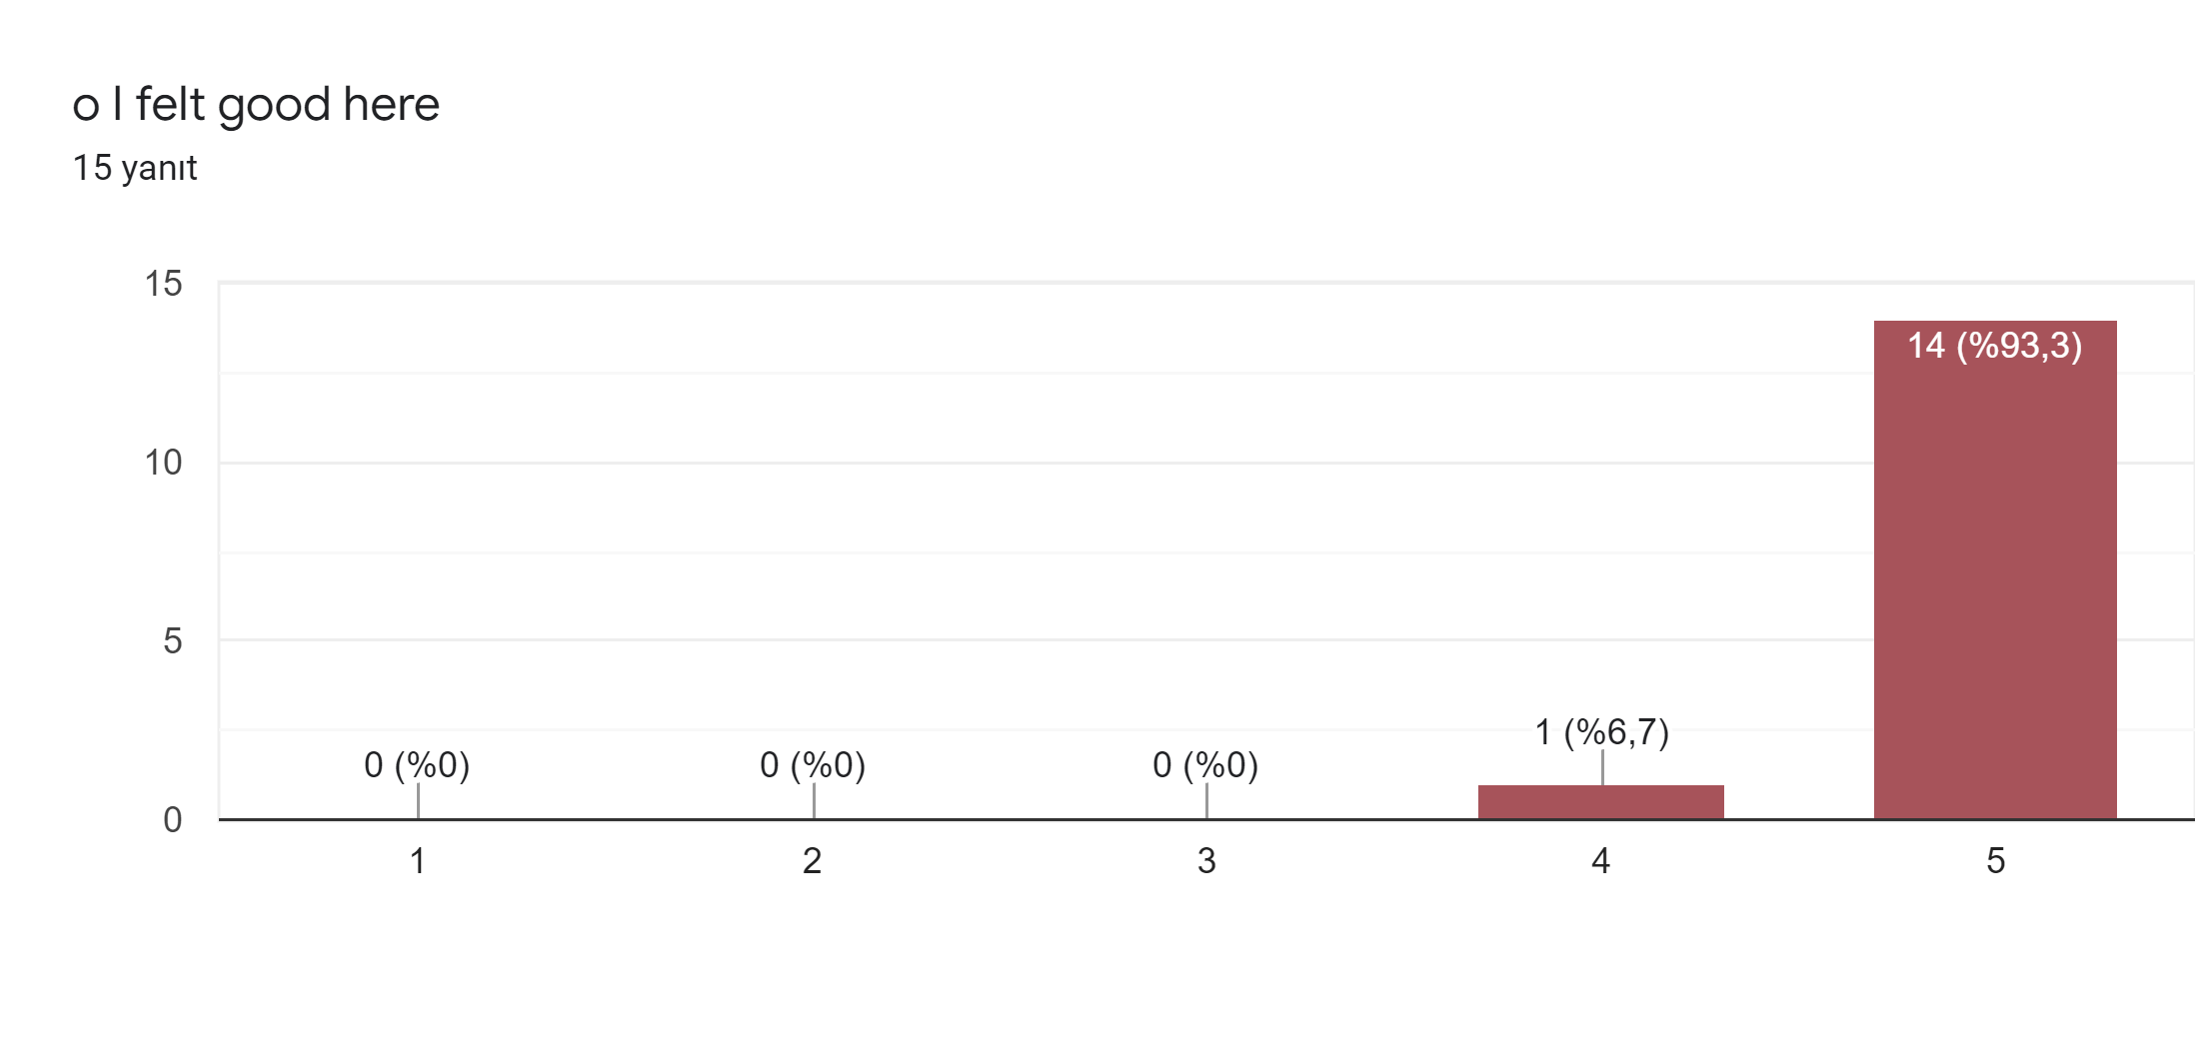

Slide 20
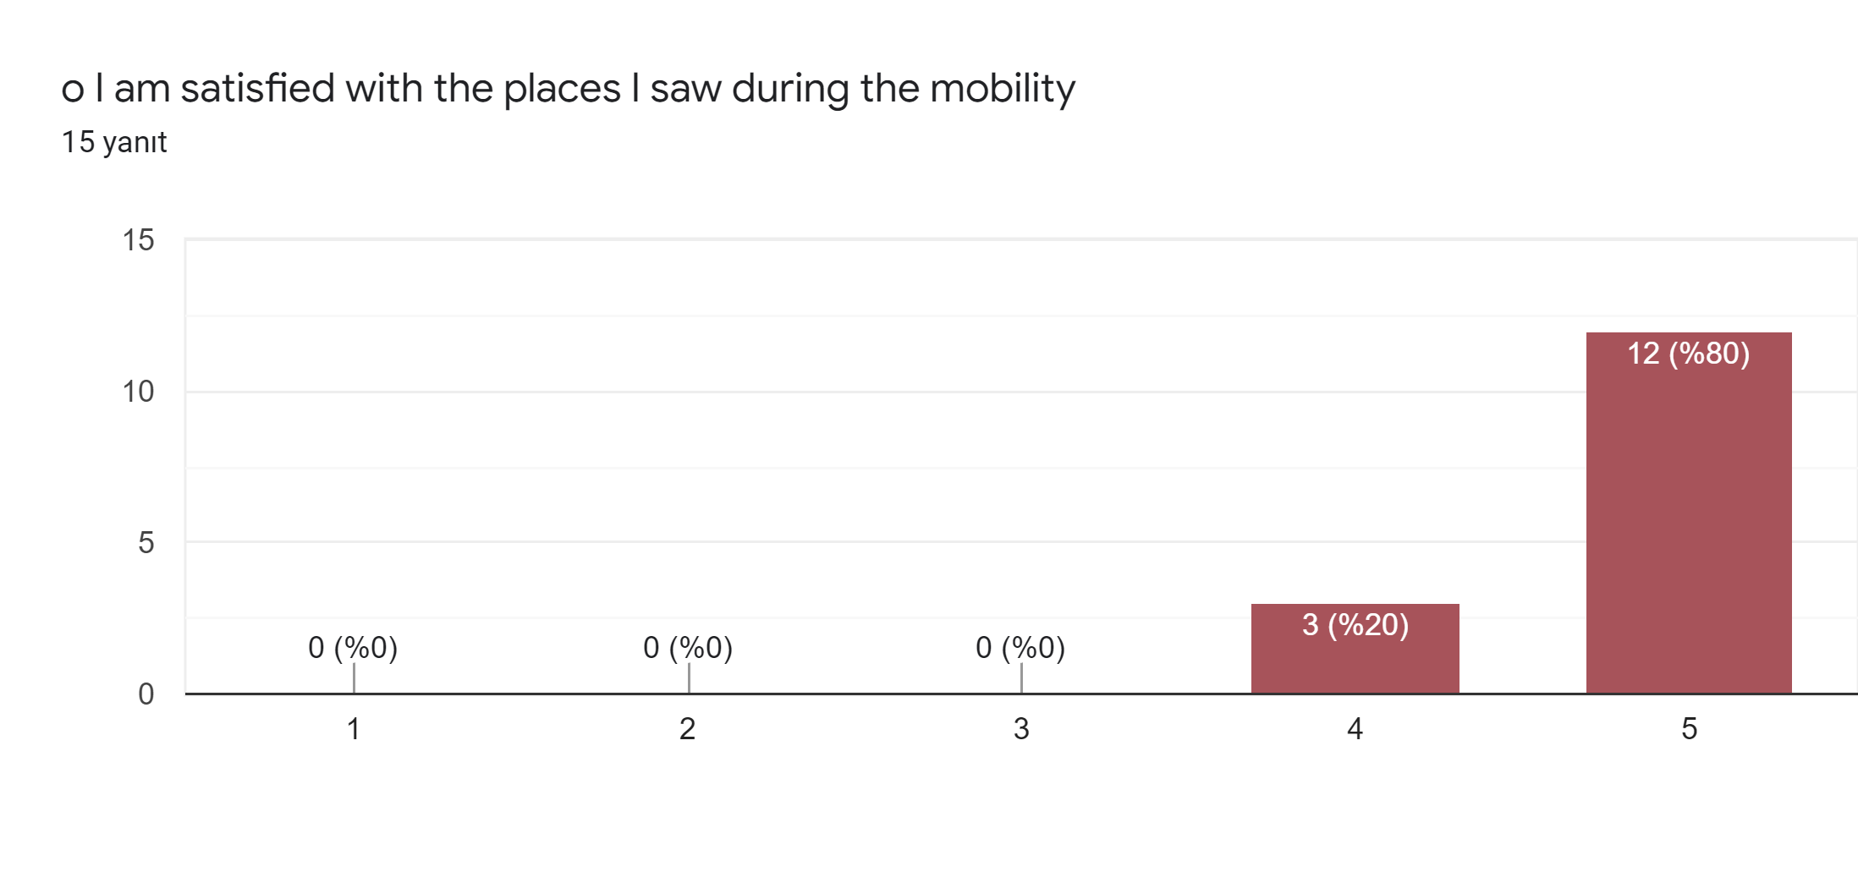

Slide 21
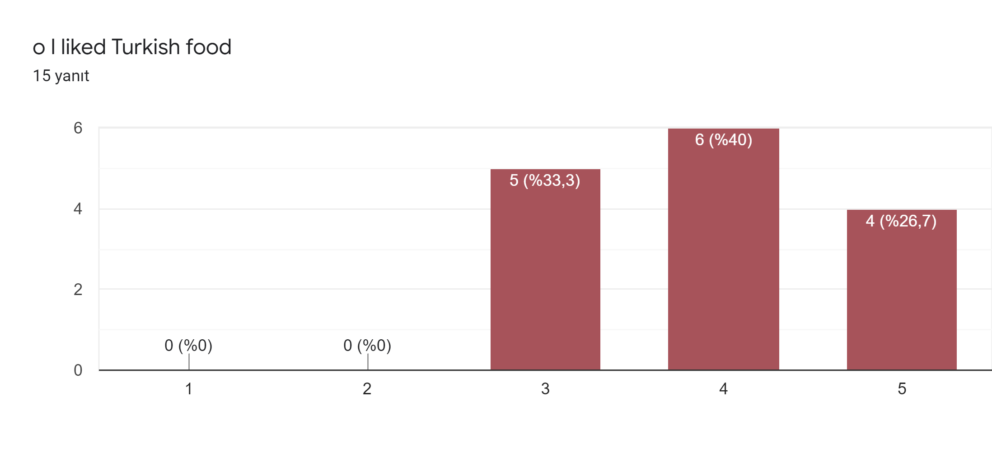

Slide 23
V. Write the best experiences for you in our country.
in your country the best experience was meeting new people, making new friends, and I really enjoyed it when we went by ferry to the restaurant on the first day
The best experience there it was the visit of all the places and saw all the interesting things about their culture and traditions.
My best experience for me in your country was the activities because I had a chance to meet new people. Every day was a new adventure and I really liked , now I have more friends that are amazing and soo lovely. I already miss them. I was so lucky to be in your country. Hope that I will see you again in the future ❤️
I can't name the one that was the best experience in this mobility, because everything was wonderful. I met new people, I laughed, I had fun, I visited many beautiful places, I made new friends, I learned to live the present, to enjoy the people and the beauty of Turkey, and all this experience turned into a story that I will share. This whole trip to Turkey was wonderful and for me it felt like a way out of reality.

Slide 24
V. Write the best experiences for you in our country.
The pool
the best experience was visiting very interesting new places
stay with the team
Meet students from other countries and visit museums
The workshop activities
I really enjoyed visiting the archaeological center of Leodichia
the visit of Rome
I liked when we went to pamukkale and when we visited all the museums.
I was very happy for this experience because i improved my English and i made new friends. I really like the museam and the acquarium.

