Slide 1
EUROPEAN SCHOOLS STAND AGAINST BULLYING
2019-1-RO01-KA229-063119_3
Short-term training courses for teachers
(07/03/2022 – 11/03/2022, İzmir)
Evaluation questionnaire
Teachers-Evaluationsheet

Slide 2
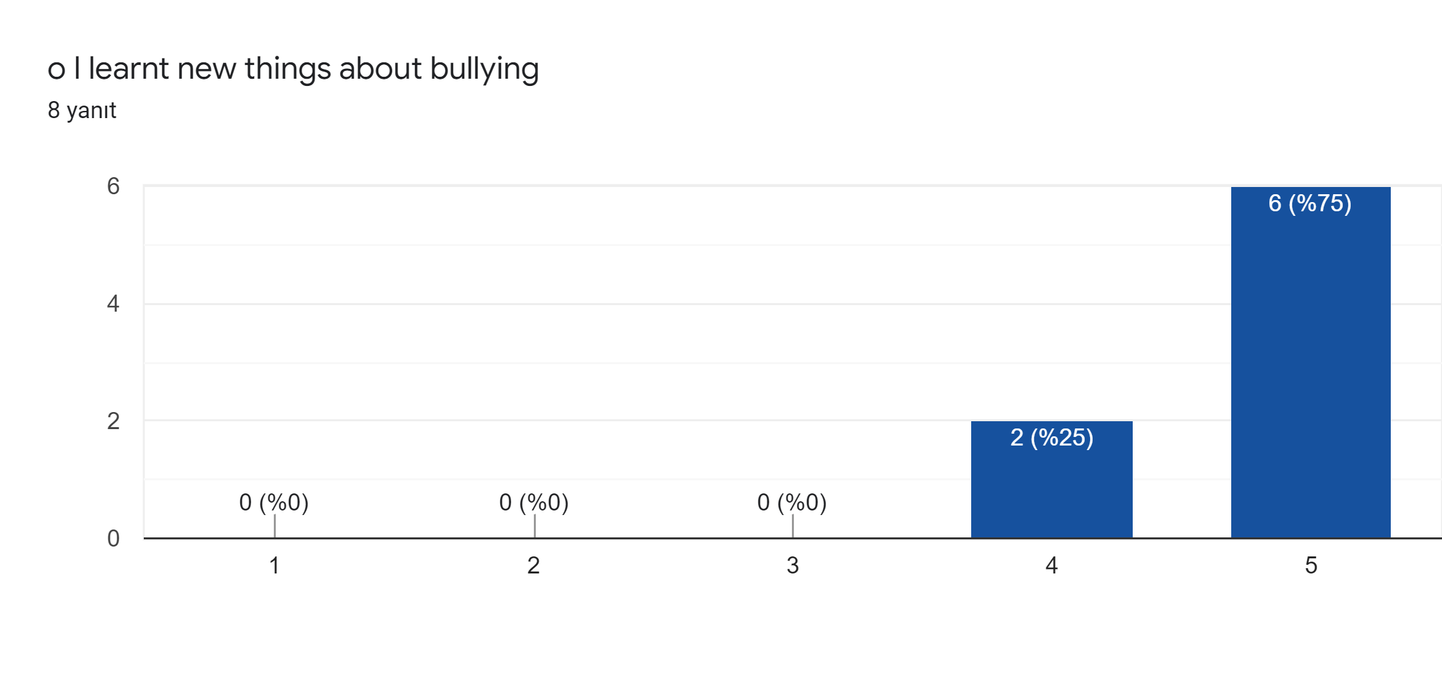

Slide 3
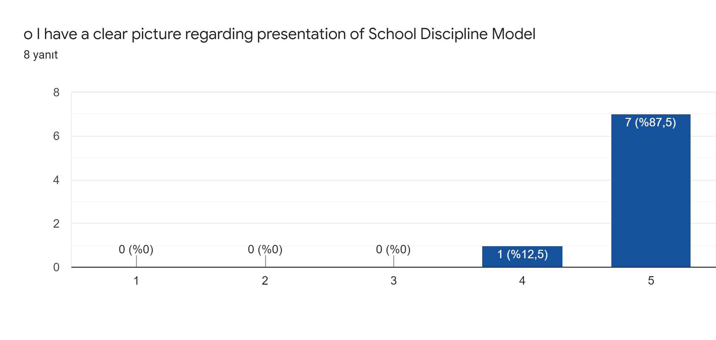

Slide 4
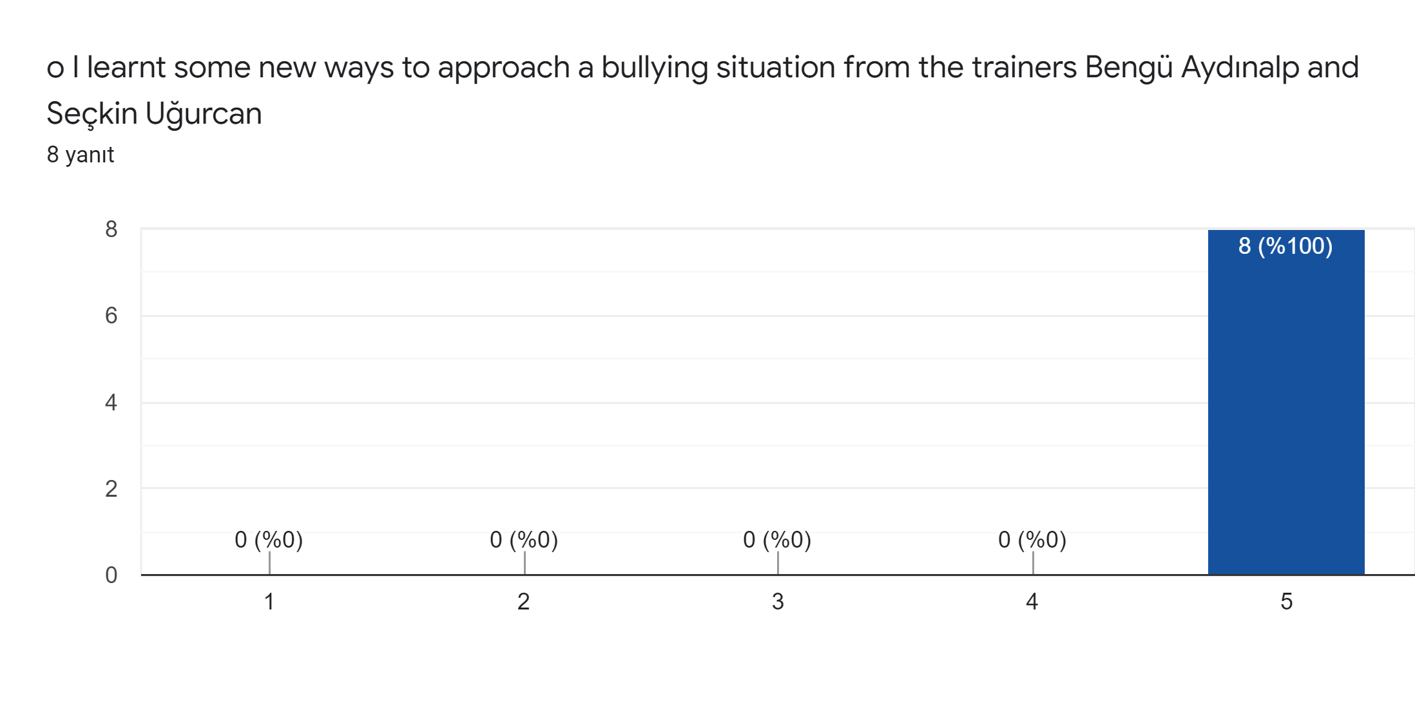

Slide 5
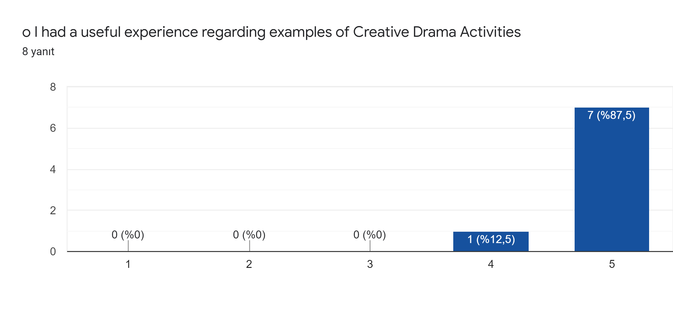

Slide 6
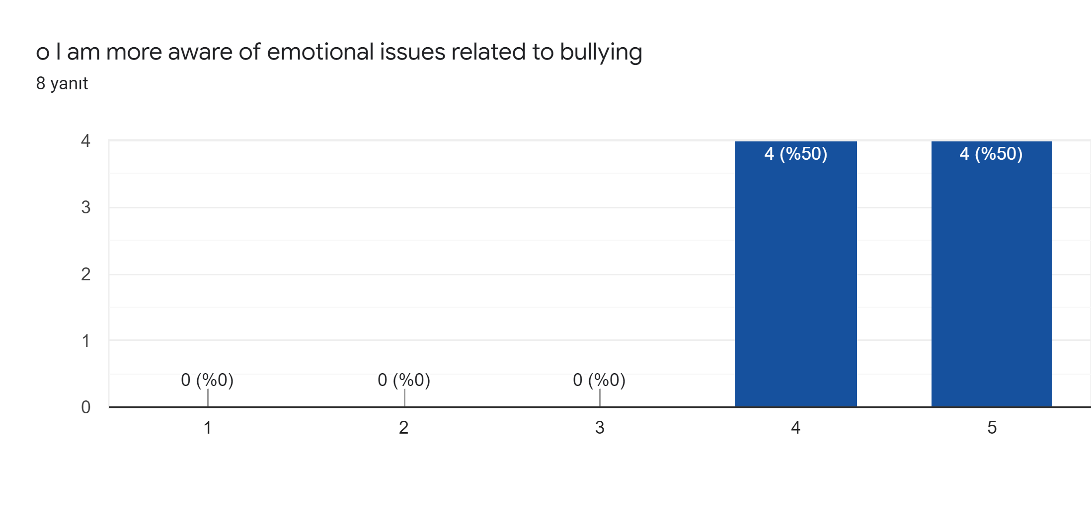

Slide 7
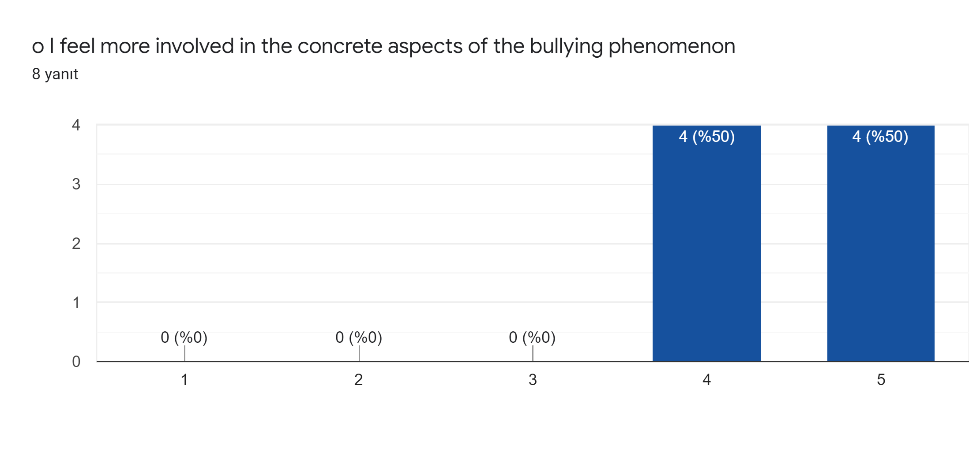

Slide 8
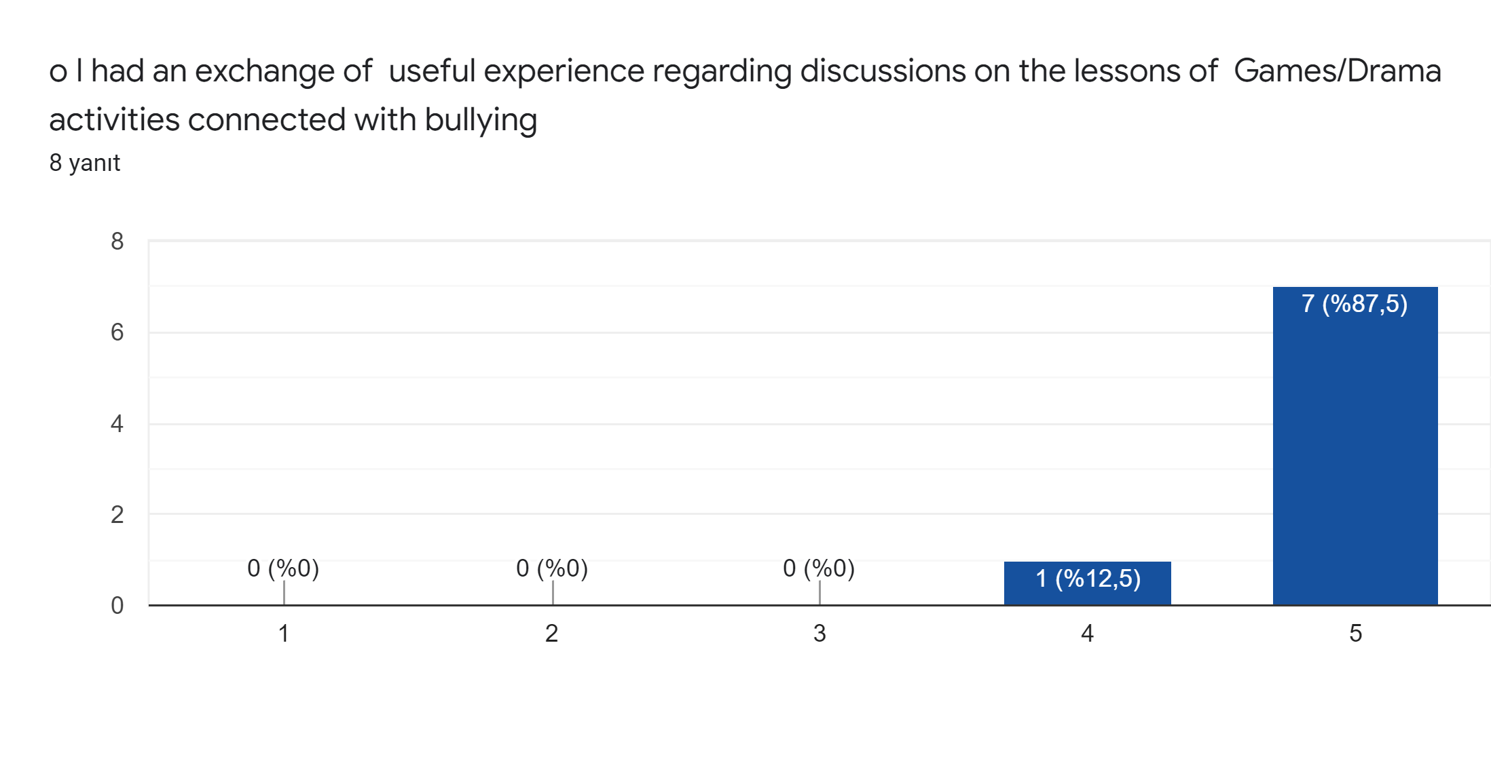

Slide 9
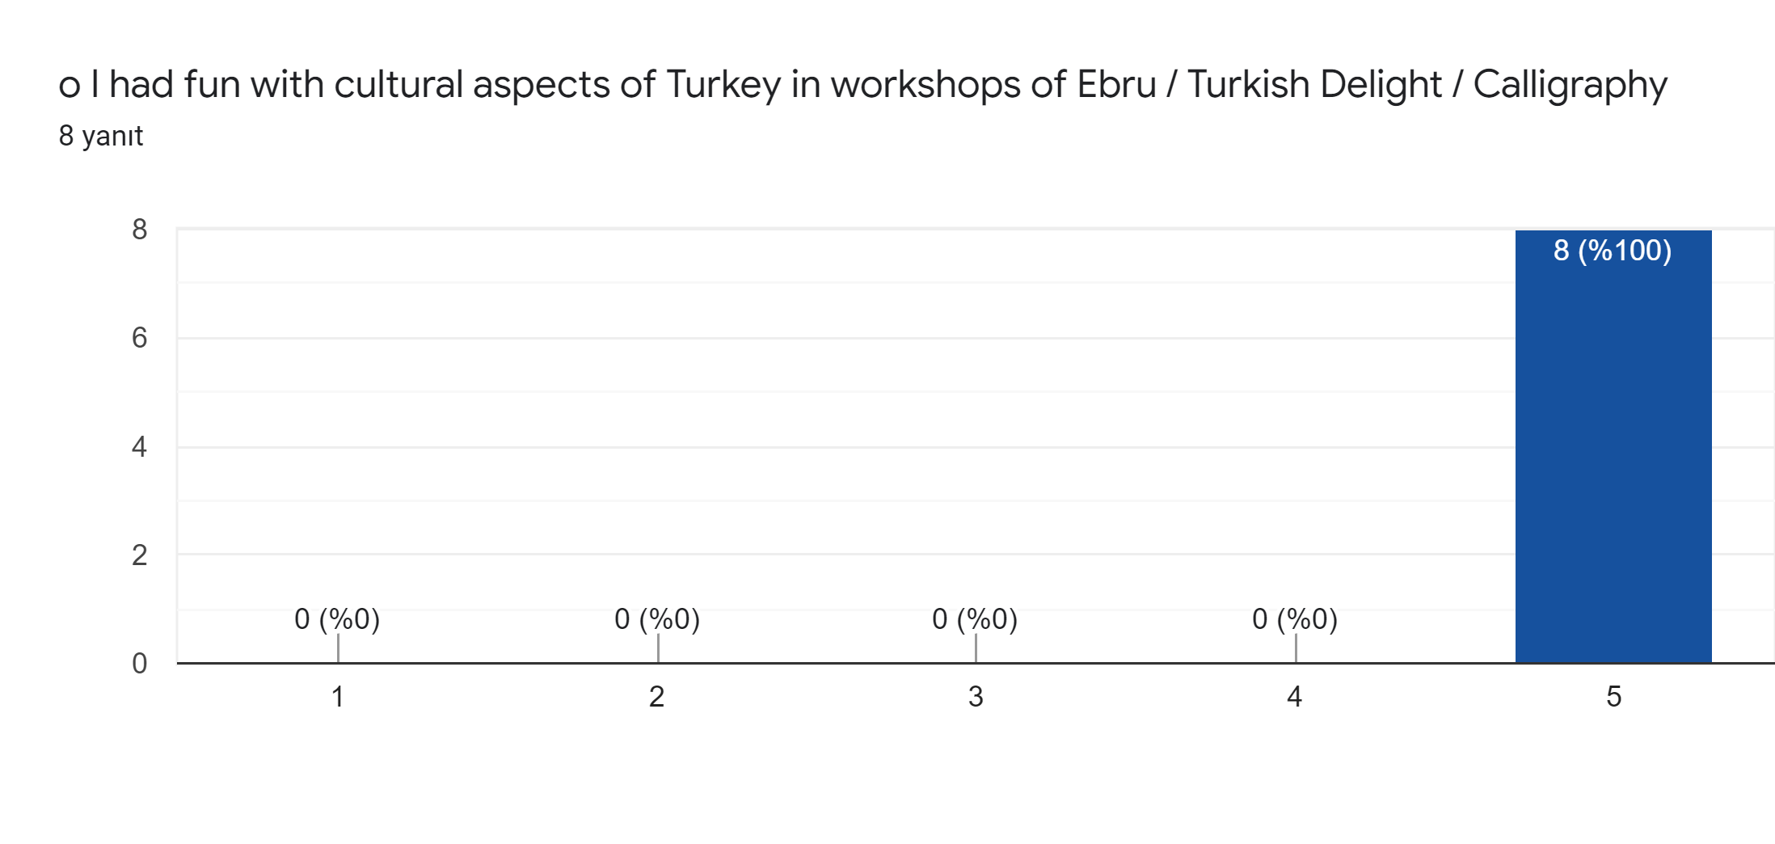

Slide 10
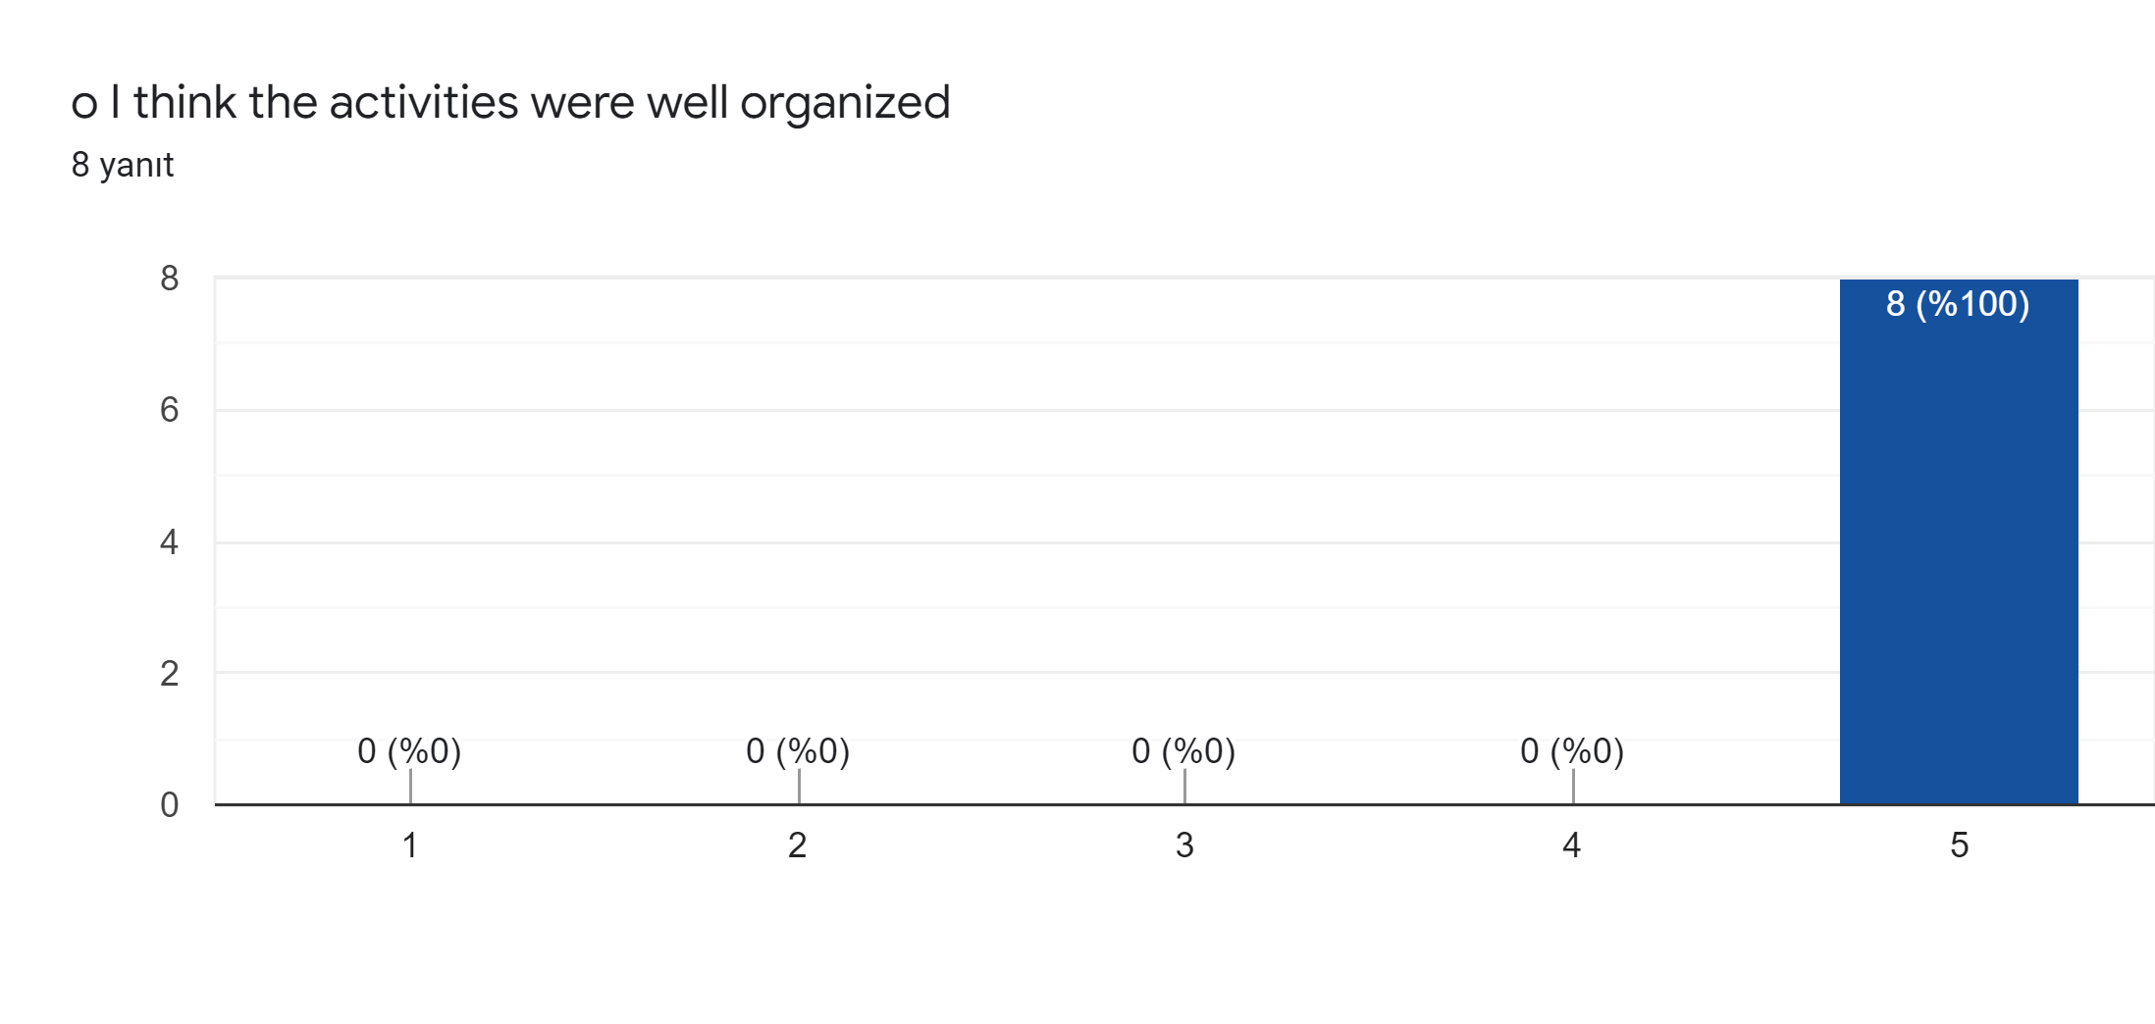

Slide 11
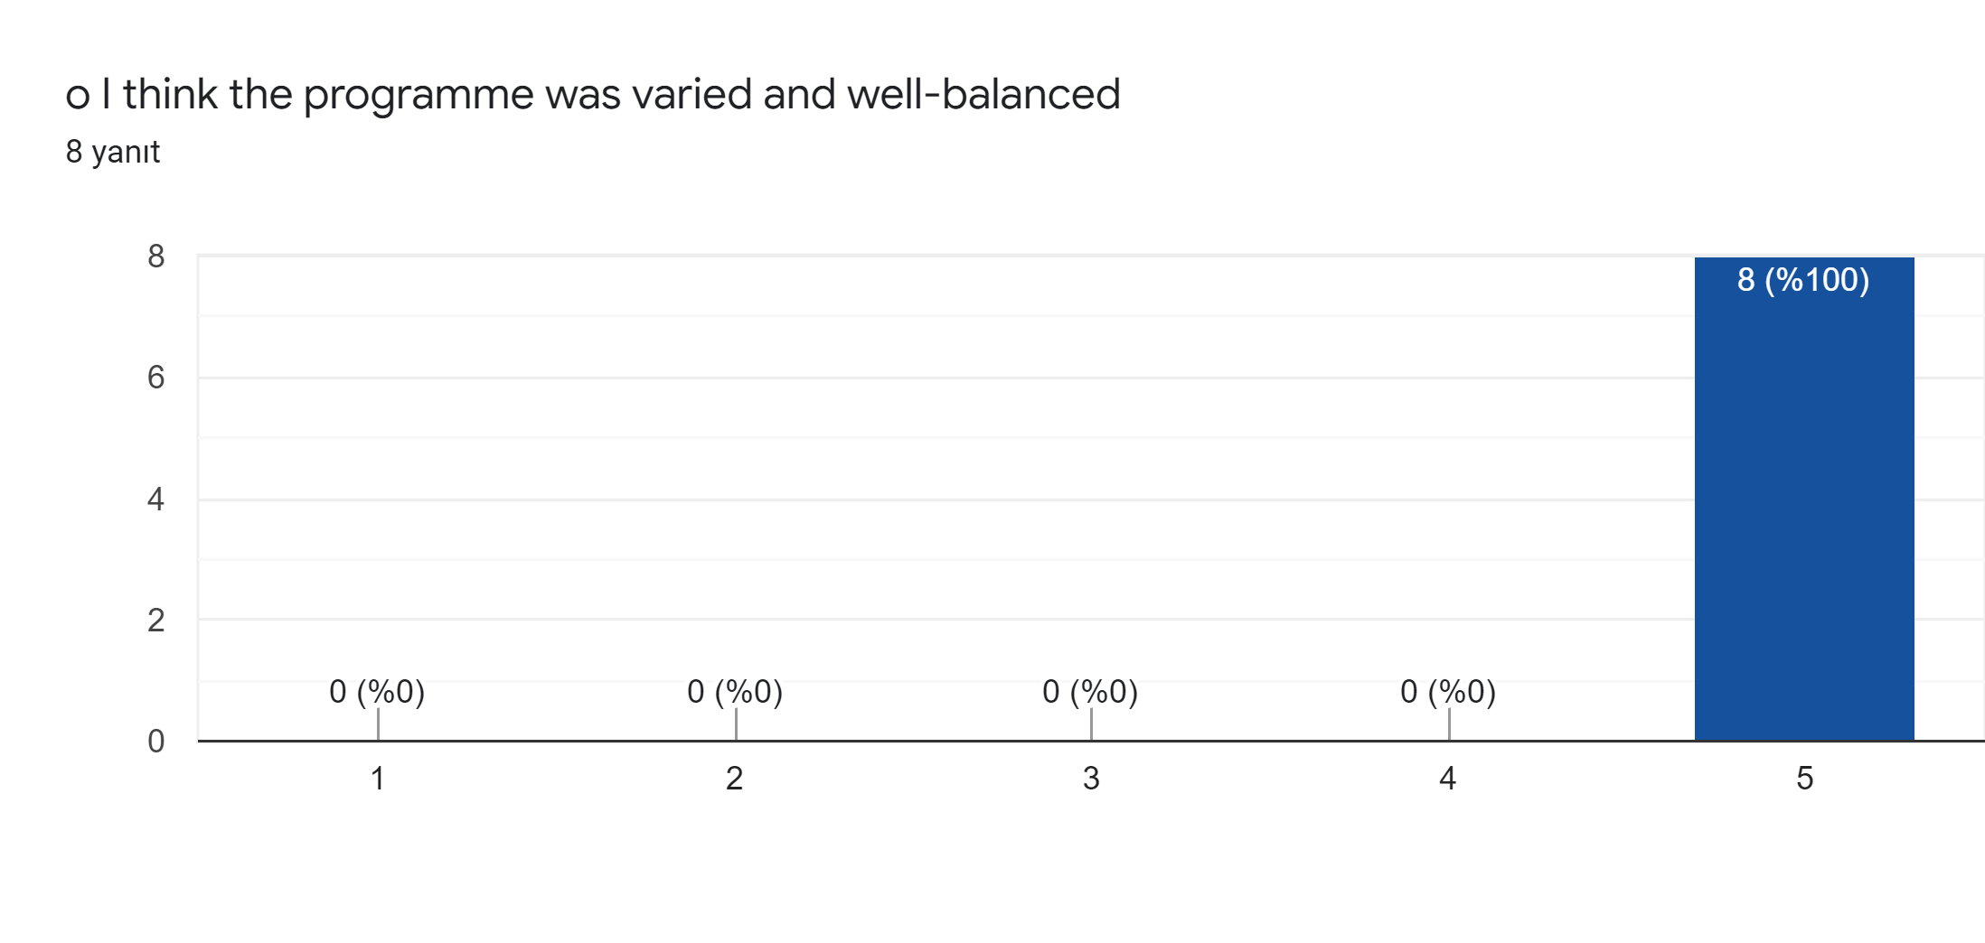

Slide 12
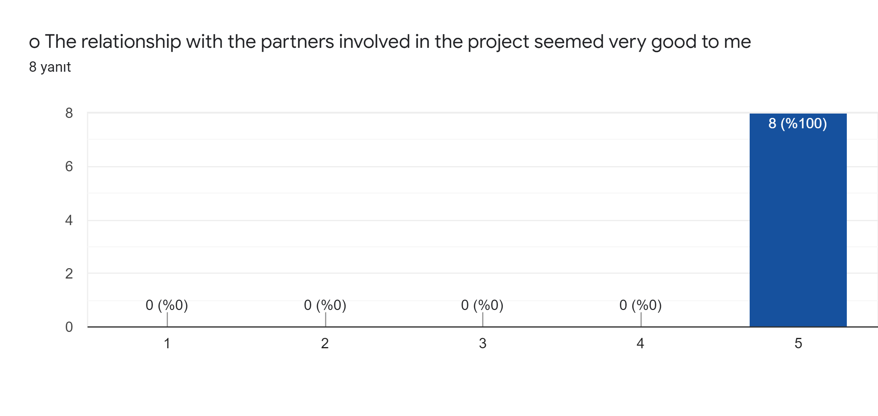

Slide 13
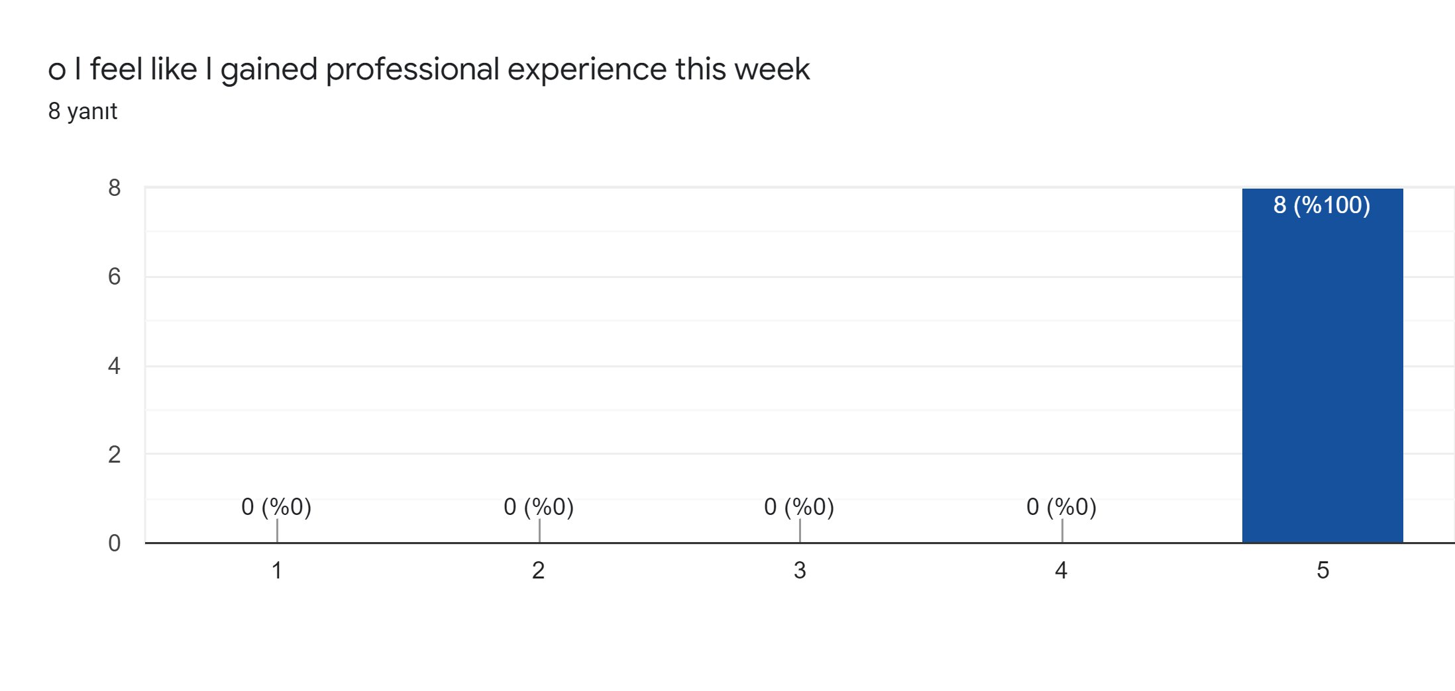

Slide 16
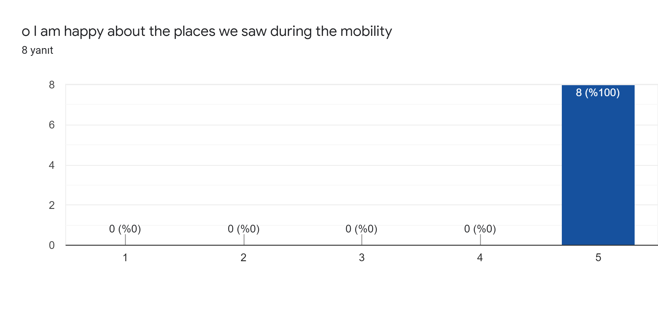

Slide 17
If you have something to add (personal impressions, suggestions, comments), please write them below
It was an Honduras for me to join succes an wonderful team.
It was a very interesting and useful experience. All the activities were very well organized and the Turkish team was fantastic. The cooperation and communication between participants were fruitful. I discover many aspects of Turkish culture and enjoyed visiting wonderful places. Many thanks to the Turkish team!
I fekt I was at home thank you
Everything was amazing and perfectly organised!
Simply amazing. Looking forward to coming back asap! Thanks for everything
Thanks for everything

